Slide 1
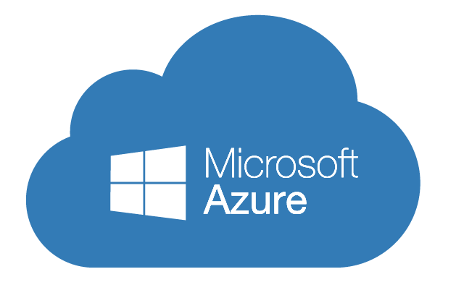
Developing Microsoft Azure Solutions
Azure Skills Developers Days
WiFi: MSFTGUEST
Password: msevent00xx
Content Location: https://github.com/MSTecs/Azure-DevDay
Notes:
Access codes for wifi should be provided on site

Slide 2

Hello! Instructor Introduction
Instructor: <Name>
<Title or other credentials, e.g. Microsoft Certified Trainer>
<Affiliation/Company>
<A few words about my technical and professional experience>
Notes:
Welcome students to the course and introduce yourself. Provide a brief overview of your background to establish credibility.

Slide 3
Day 1 – Date
Agenda
8:30 AM |  | Registration & Breakfast
8:45 AM |  | Welcome
9:00 AM |  | Agenda Overview
9:15 AM |  | Overview of the Microsoft Azure Platform
10:15 AM |  | Break
10:30 AM |  | Building Application Infrastructure in Azure
12:00 PM |  | Hands-On Labs / Lunch / Networking
1:00 PM |  | Hosting Web Applications on the Azure Platform
2:00 PM |  | Break
2:15 PM |  | Storing SQL Data in Azure
3:15 PM |  | Hands-On Labs
3:45 PM |  | Storing Unstructured Data in Azure
4:30 PM |  | Wrap-Up / End of Day 1
Notes:
Tentative Agenda

Slide 4
Day 2 – Date
Agenda
9:00 AM |  | Registration & Breakfast
9:30 AM |  | Storing and Consuming Files from Azure Storage
10:15 AM |  | Hands-On Labs
10:45 AM |  | Break
11:00 AM |  | Designing a Communication Strategy by Using Queues and Service Bus
12:00 PM |  | Lunch Break
12:30 PM |  | Securing Azure Web Applications
1:15 PM |  | Hands-On Labs
1:45 PM |  | Continuous Integration and Continuous Deployment
2:30 PM |  | DevOps Testing
3:00 PM |  | Break
3:15 PM |  | Application Monitoring and Feedback Loops
4:00 |  | Hands-On Labs
4:30 PM |  | Q&A: How will you use what you have learned / Wrap-Up
Notes:
Tentative Agenda

Slide 5
About this course: Audience
This course is intended for students who have experience building web applications. Students should also have experience with the Microsoft Azure platform and a basic understanding of the services offered in Azure.
The candidates targeted by this training have basic experience in implementing and monitoring Microsoft Azure solutions. Candidates are also proficient with the development tools, techniques, and approaches used to build application solutions using C#.
Notes:
Describe the audience for this course. This is an opportunity for you to identify students who may not have the appropriate background or experience to attend the course.

Slide 6
About this course: Objectives
After completing this course, students will be able to:
Compare the services available in the Azure platform
Configure and deploy web applications
Creating Azure Web Apps from the gallery
Deploy and monitor Azure Web Apps
Create and configure Azure virtual machines
Create and manage a storage account
Manage blobs and containers in a storage account
Create, configure, and connect to a SQL Databases instance
Identify the implications of importing a SQL standalone database
Manage users, groups, and subscriptions in an Azure Active Directory instance
Create a virtual network

Slide 7
Microsoft Certification Program
Get trained. Get certified.
Get ahead.
Microsoft Certifications demonstrate that you have the skills to design, deploy, and optimize the latest technology solutions.
Ask your Microsoft Learning Partner how you can prepare for certification.
For more information about Microsoft Certifications, go to:
https://www.microsoft.com/learning/certification
Microsoft Certified Solutions Expert (MCSE)
Microsoft Certified Solutions Associate (MCSA)
Notes:
Mention to the students that this course is not associated with any Microsoft certification path.

Slide 8
Azure Certification Path
MCSA: Cloud Platform
Two Electives
Exam 70-532
Exam 70-533
Exam 70-535
Exam 70-537
Developing Microsoft Azure Solutions
OR
Implementing Microsoft Azure Infrastructure Solutions
OR
Architecting Microsoft Azure Solutions
OR
Configuring and Operating a Hybrid Cloud with Microsoft Azure Stack
Course 20532D
Course 20533C
Course 20535A
Course 20537A
Developing Microsoft Azure Solutions
Implementing Microsoft Azure Infrastructure Solutions
Architecting Microsoft Azure Solutions
Configuring and Operating a Hybrid Cloud with Microsoft Azure Stack
Notes:
To earn the MCSA, students must select two electives from this pool of courses.

Slide 9
Azure Certification Path
MCSA: Linux on Azure
Exam 70-533
LFCS:
Implementing Microsoft Azure Infrastructure Solutions
Linux Foundation Certified System Administrator
Course 20533D
Implementing Microsoft Azure Infrastructure Solutions
Notes:
This is an open-source alternative to the MCSA: Cloud Platform.
Students simply need to earn the LFCS from the Linux Foundation: https://training.linuxfoundation.org

Slide 10
Azure Certification Path
MCSE: Cloud Platform and Infrastructure
One Elective
Exam 70-532
Exam 70-533
Exam 70-535
Exam 70-473
Developing Microsoft Azure Solutions
OR
Implementing Microsoft Azure Infrastructure Solutions
OR
Architecting Microsoft Azure Solutions
OR
Designing and Implementing Cloud Data Platform Solutions
Exam 70-475
Exam 70-744
Exam 70-745
Exam 70-413
Designing and Implementing Big Data Analytics Solutions
OR
Securing Windows Server 2016
OR
Implementing a Software-Defined Datacenter
OR
Designing and Implementing a Server Infrastructure
Exam 70-414
Exam 70-537
Exam 70-538
Exam 70-539
Implementing an Advanced Server Infrastructure
OR
Configuring and Operating a Hybrid Cloud with Microsoft Azure Stack
OR
Implementing Microsoft Azure DevOps Solutions
OR
Managing Linux Workloads on Azure
MCSA: Linux on Azure
MCSA: Cloud Platform
MCSA: Windows Server 2012
MCSA: Windows Server 2016
Notes:
To earn the MCSE, students must select one additional elective (not used in the MCSA pool) from this pool.

Slide 11
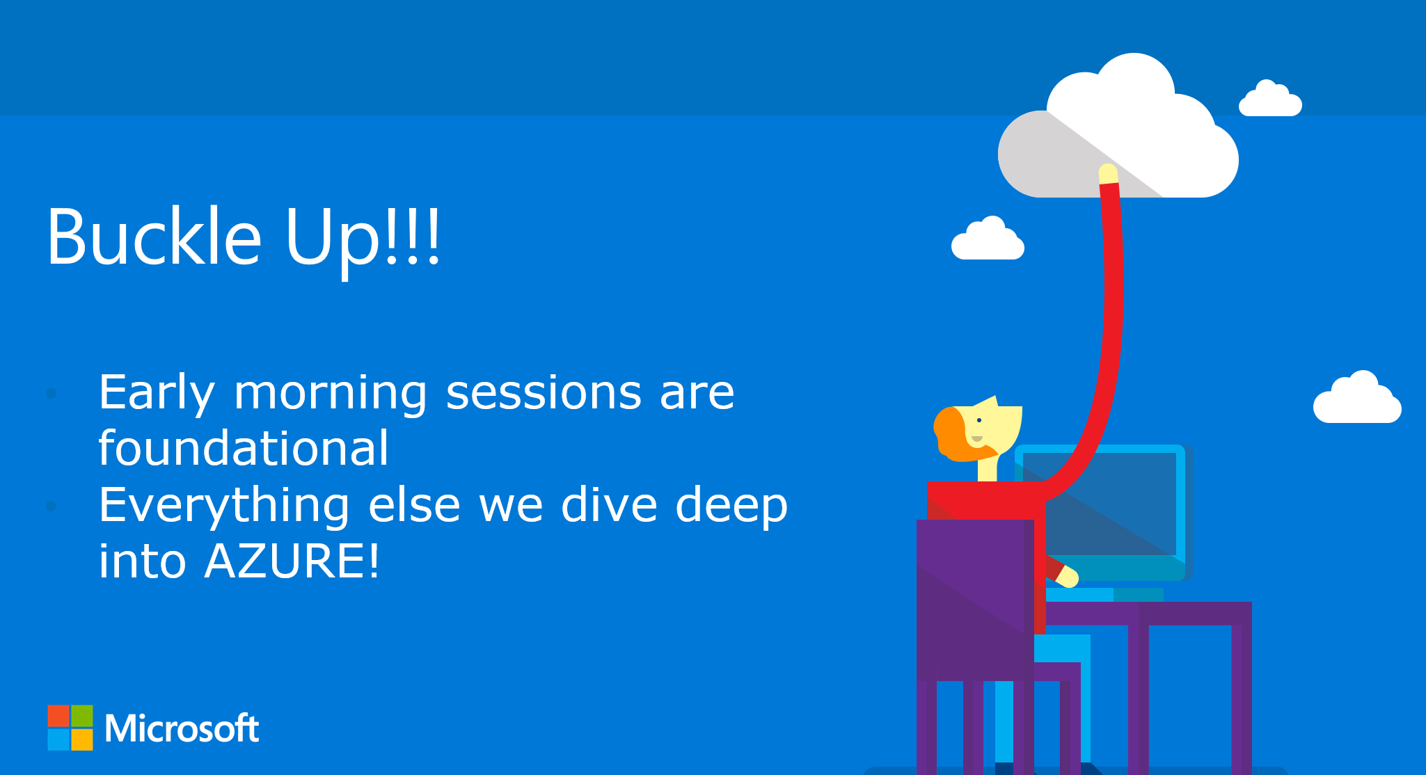
Notes:
This module is a recap of the Microsoft Azure services and features that students should already be familiar with before taking this course. The Azure Portals lesson ensures that all students, experienced or novice, have the same understanding of the Azure Portal.
20532D
1: Overview of the Microsoft Azure Platform

Slide 12
Module 1
Overview of the Microsoft Azure Platform
Notes:
This module is a recap of the Microsoft Azure services and features that students should already be familiar with before taking this course. The Azure Portals lesson ensures that all students, experienced or novice, have the same understanding of the Azure Portal.
20532D
1: Overview of the Microsoft Azure Platform

Slide 13
Module Overview
Azure Services Azure Portal
Notes:
Microsoft Azure provides a collection of services that you can use as building blocks for your cloud applications. Lesson 1, “Azure Services,” provides a recap of the services that you might have worked with when using the Microsoft Azure platform in the past. Lesson 2, “Azure Portal," describes the Azure portal that is available for managing Azure subscriptions and services.
Objectives
After completing this module, you will be able to:
• Describe some of the common Azure services.
• Describe features of the Azure Portal.
20532D
1: Overview of the Microsoft Azure Platform

Slide 14
Lesson 1: Azure Services
Services Overview Web Apps Virtual Machines Storage SQL Database Virtual Networks App Services
Notes:
This lesson describes some of the common services and features, used by many entry-level Azure developers and IT professionals, which are available in Azure. Although not comprehensive, this feature
list represents many of the services that you might have used prior to taking this course.
Lesson Objectives
After completing this lesson, you will be able to:
• Describe the following Azure services:
o Web Apps
o Virtual Machines
o Storage
o SQL Database
o Virtual Network
20532D
1: Overview of the Microsoft Azure Platform

Slide 15
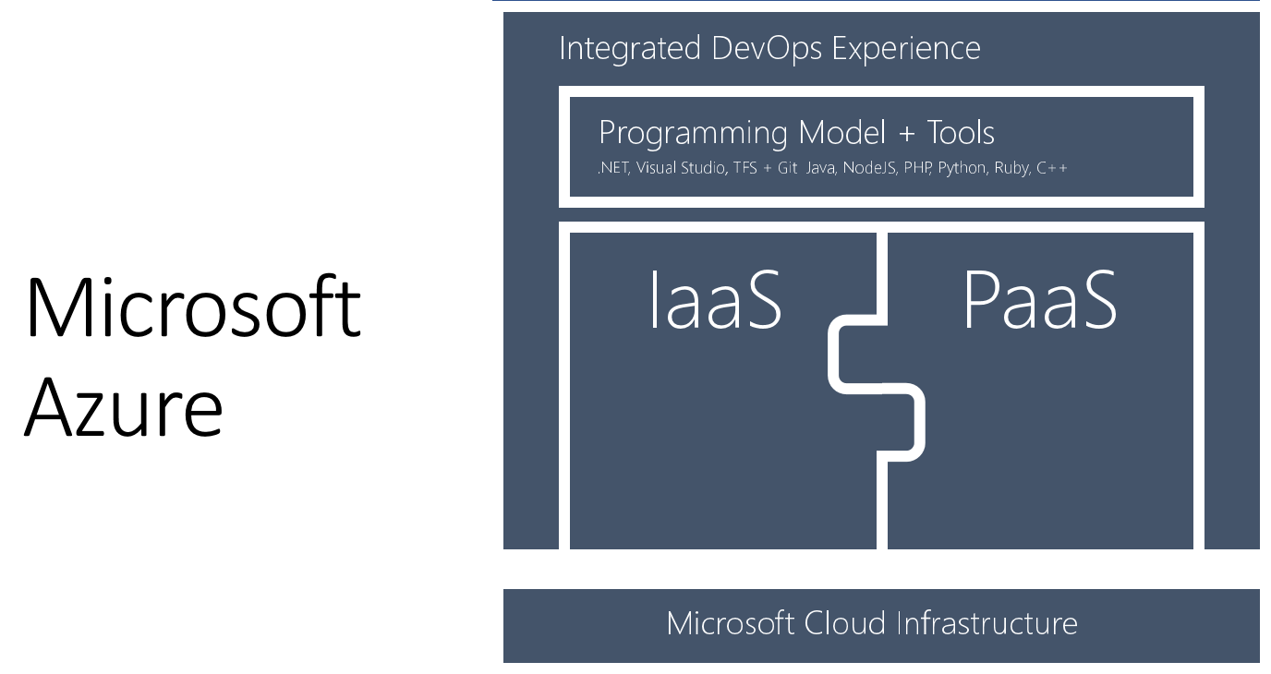
Azure Platform
Notes:
20532D
1: Overview of the Microsoft Azure Platform

Slide 16
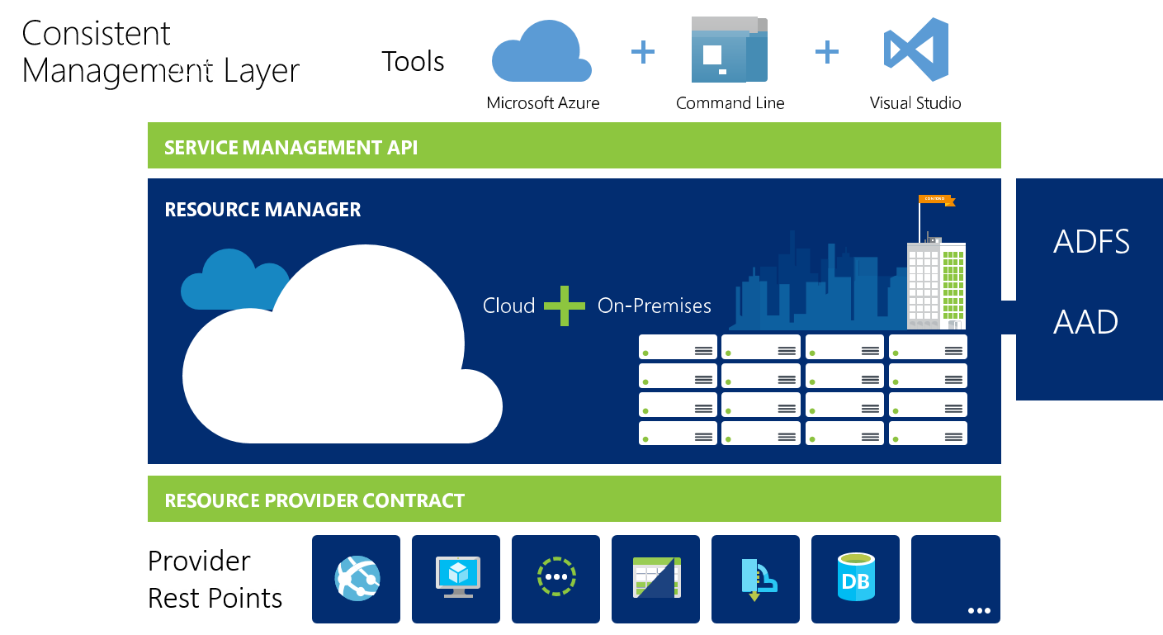
Management Layer
Notes:
20532D
1: Overview of the Microsoft Azure Platform

Slide 17
Services Overview
Microsoft Azure is a collection of services
Communication Infrastructure
Data Streaming and Storage
Web Hosting
Mobile Connectivity
Notes:
The Azure platform is a collection of services that allows you to host existing workloads, use managed services instead of a workload, and create greenfield workloads. In the majority of projects, you might use only a subset of the available services in the Azure platform. It is very typical to find varying levels of experience amongst your peers. In this course, you will learn about the most common services that you can use in new development projects that will be hosted on the Azure platform.
Physical Infrastructure Alternatives
Services such as Virtual Machines and Virtual Network help in emulating the existing infrastructure in your datacenter.
Communication Infrastructure
Cloud applications are typically modular in nature and require a managed communication infrastructure, such as Service Bus, to connect the various application modules.
Data Streaming and Storage
The managed Storage service can handle a wide range of file persistence and manipulation scenarios
Web Hosting
For low-friction development and deployment, the Web Apps service provides a web hosting platform for your applications that integrate with File Transfer Protocol (FTP), source control providers, or the Web
Deploy protocol.
Mobile Connectivity
Mobile Apps is a fully managed back-end service solution for client devices. Together with SQL Databases, Mobile Apps can help you design your data schema while you scale up to meet the demand from your
users.
20532D
1: Overview of the Microsoft Azure Platform

Slide 18
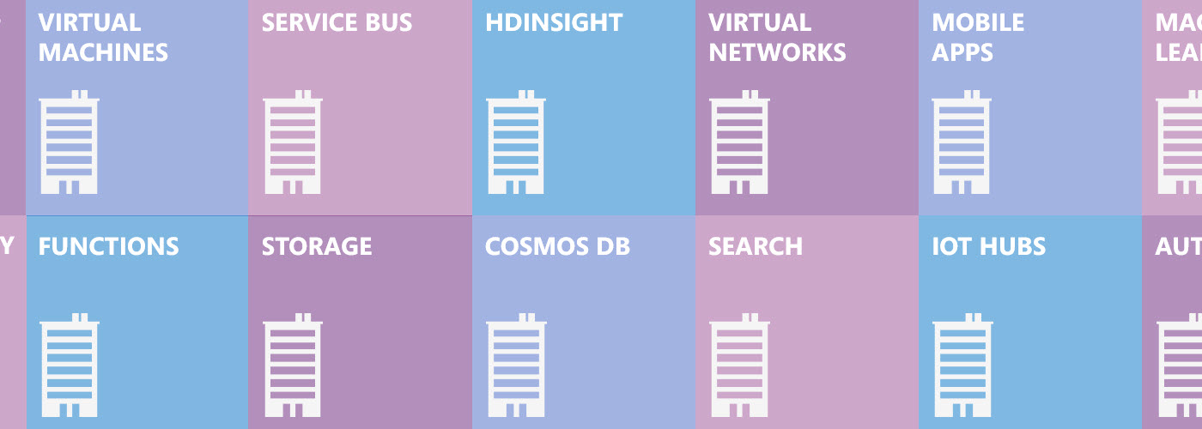
Services Overview
In a typical project, there are many Azure services to choose from:
Notes:
20532D
1: Overview of the Microsoft Azure Platform

Slide 19
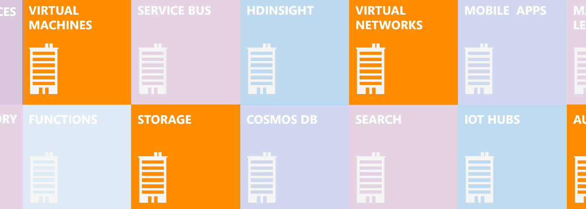
Services Overview
You may only use a small subset of the available services:
Notes:
20532D
1: Overview of the Microsoft Azure Platform

Slide 20
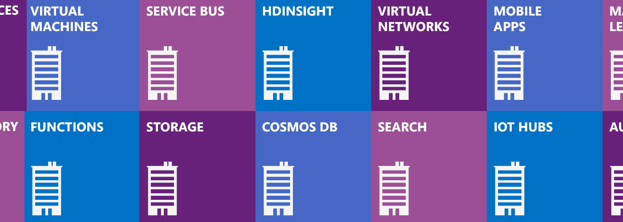
Services Overview
You may only use a small subset of the available services:
In this course, you will learn about many of the services that you could use in your projects
Notes:
20532D
1: Overview of the Microsoft Azure Platform

Slide 21
Web Apps
Azure Web Apps is a Platform-as-a-Service offering that allows you to quickly and easily deploy and scale up a web application
Features:
Create a Web App instance from the gallery
Create and use App Service plans
Deploy test or staging versions using slots
Change between the Free, Shared, Basic, and Standard modes
Deploy from a source control provider
Notes:
Web Apps
Web Apps provides platform for your web applications with many features to reduce the friction of deployment. A high degree of compatibility with Internet Information Server (IIS) Web Apps allows you to configure your web applications by using familiar IIS configuration settings. Because the platform is highly managed, you can scale up your web applications automatically with load balancing, which is also
configured automatically.
20532D
1: Overview of the Microsoft Azure Platform

Slide 22
Virtual Machines
Infrastructure-as-a-Service offering that allows you to deploy compute instances in minutes to be used for Windows or Linux workloads
Features:
Use images built by the product teams to deploy workloads such as SQL Server, SharePoint, and Apache
Attach, format, and configure multiple disks for a VM
Remotely connect to a Windows or Linux VM
Select between VM sizes (A0-A9)
Select a Basic or Standard tier VM
Notes:
It is important to remind the students that they don’t necessarily have to memorize the virtual machine sizes. They simply need to understand that there are multiple virtual machine sizes, and they need to keep in mind certain considerations while selecting a virtual machine size for their instance. They also should understand that the Basic and Standard tiers have slightly different performance levels for each size (IOPS typically).
Discussion Question: How do you remotely connect to a Windows–based virtual machine and a Linux–based virtual machine?
Virtual machines provide compute on demand for your application workloads with a high degree of compatibility with existing virtualization workloads.
Workloads
Virtual machines support a list of common Microsoft application workloads. Software platforms such as Microsoft SharePoint, SQL Server, Dynamics GP, and BizTalk Server are fully supported using the infrastructure hosted in Azure. By connecting Virtual Machines to your on-premises network, you can enable disaster-recovery and high-availability solutions such as SQL Server AlwaysOn.
Templates
You can create the majority of supported workloads in Azure by using pre-built templates on the portal. Microsoft and third-party images are available for both Linux and Microsoft-supported application
workloads. Standard operating system images for Windows and Linux are also available for new projects.
Choice in Sizing
You can configure virtual machines with a variety of options for CPU, memory, and IOPS, commonly referred to as VM sizes. The Basic and Standard sizes are available for the most common application
workloads. Larger standard sizes are also available for memory intensive workloads. D-size virtual machines are available with a faster processor and a local solid-state drive (SSD). G-size virtual machines
are available for workloads that require massive compute or memory resources.
20532D
1: Overview of the Microsoft Azure Platform

Slide 23
Storage
Reliable and scalable storage service for data of all types and sizes
Features:
Select a datacenter for storage
Configure geo-replication options
Manage blobs and files
Secure a container
Upload files
Access files
Notes:
Storage
Storage is a managed service that allows you to store data that can be used throughout your cloud applications. The data that is stored can include loosely structured entities, queue messages, and various files.
Queues
The Queue service provides a simple managed interface to push messages into a queue and consume the
same messages. Messages are stored as serialized strings. They can be stored or retrieved in a First-In
First-Out manner by using logical queue actions, such as enqueue, dequeue, and peek.
Tables
The Table service is a NoSQL store that allows you to store loosely structured sets of entities that can be
persisted en masse and retrieved with exception efficiency. By implementing common sharding concepts,
such as partitions and hash indexes, you can use tables to store large quantities of data for your
application.
Files
The Azure Files service provides an SMB 2.1 protocol file share that you can use when you migrate
existing application workloads from on-premises to Azure. The files that are persisted by using this
technology can also be accessed by using the REST API or client libraries.
20532D
1: Overview of the Microsoft Azure Platform

Slide 24
SQL Database
SQL Database is a Database-as-a-Service offering that makes SQL databases accessible for cloud developers
Features:
Create a logical SQL Server or SQL Database instance
Configure a SQL Server instance firewall
Compare the SQL Database service and Standalone SQL Server in an Azure virtual machine
Use SQL Server Data Tools, Azure SQL Database Management Portal, and SQL Server Management Studio to connect to a database instance
Notes:
It is not necessary for the students to have experience with all the above mentioned tools. They just need to know how to use an existing tool to connect to an Azure SQL Database instance. // SQL Database is a managed Database-as-a-Service platform that you can use to host your SQL objects.
Compatibility
Many SQL features and objects can be used with SQL Database. SQL Server 2014 provides tooling that you can use to analyze and migrate your databases from an on-premises server to Azure.
Data Tools
You can use many existing data tools such as SQL Server Data Tools for Microsoft Visual Studio and SQL Server Management Studio with SQL Database. Other tools and application frameworks can use
connection strings to connect to the databases that are hosted in Azure.
Scalability
Elastic Scale can be used with a SQL Database instance to automatically create and manage defined partitions for applications with dynamic or large database workloads. Applications that can benefit from
this feature range from large data stores to multitenant Software-as-a-Service (SaaS) services.
20532D
1: Overview of the Microsoft Azure Platform

Slide 25
Virtual Networks
Private network that is available for grouping of services and compute instances in the cloud or on-premise
Features:
Create a Virtual Network (VNET) specifying a region or affinity group
Configure a VNET to use a DNS server
Configure VNET subnets
Implement a point-to-site connection to a VNET
Create a virtual machine in an existing VNET
Notes:
Some of the students might not have implemented a Point-to-Site connection to a virtual network. Encourage them to use the tutorials that are available at the following location:
Reference Links: http://go.microsoft.com/fwlink/?LinkID=510169
Virtual networks are a security boundary that you can create so that service instances can communicate with each other privately. Virtual networks support instances of the Web Apps, SQL Databases, and Virtual Machines services.
Site Connectivity
You can connect virtual networks with each other or with an existing on-premises network by using the Internet Protocol Security (IPSec) protocol.
Direct Connectivity
The Secure Sockets Tunneling Protocol (SSTP) can also be used to allow an individual device or a computer to directly connect to a virtual network by using a Point-to-Site virtual private network (VPN) connection.
Domain Name Service (DNS)
Azure automatically provides a DNS service for virtual machines and services in a virtual network.
20532D
1: Overview of the Microsoft Azure Platform

Slide 26
App Services
Azure provides a collection of services that you can integrate in new or existing applications to enhance their functionality
Examples:
Azure Active Directory
Media Services
Mobile Services
Automation
Notes:
Students do not need existing experience with any of these services. They simply need to be aware of these services so that they can select the appropriate service for a specific task.
Experience with Azure Active Directory will be helpful for the security module in this course, but is not absolutely required.
Discussion Question: Can you name an Azure service that is not listed here, but you have used in the past?
App Services
Azure provides many other services for your cloud applications. The following sections describe some of these services.
Azure Active Directory (Azure AD)
Azure AD is a managed identity and access service. You can use this service to provide authentication and single sign-on capability for cloud applications or any custom application.
Media Services
Media Services is a service that allows you to encode and stream multimedia for a wide variety of customers and devices.
Mobile Services
Mobile Services is a back-end service platform that you can use to store and provide application data for mobile devices.
Automation
Automation extends your management features by allowing you to use Windows PowerShell to automate common management tasks.
20532D
1: Overview of the Microsoft Azure Platform

Slide 27
Lesson 2: Azure Portal
The Azure Portal Portal Features Demonstration: Using the Azure Portal
Notes:
Many iterations of Azure services and the web applications to manage those services are currently available.
This lesson describes the last two iterations of the Azure Portal, which you can use for configuring instances of Azure services. This lesson also provides a walkthrough of how to switch between the two
Azure Portals when the functionality you require is not available in one of the portals.
Lesson Objectives
After completing this lesson, you will be able to:
• Describe the current Azure Portal.
• Describe the Classic Azure Portal.
• Switch between the different portals.
20532D
1: Overview of the Microsoft Azure Platform

Slide 28
The Azure Portal
Unified management experience and marketplace
Fine-grained access control
Personalize your workspace
Billing insights
Self-service support and ticket management
Notes:
Do not spend too much time on this slide because the next topic demonstrates the Portal.
The Azure Portal
Azure as a platform is a collection of services that you can use to host your applications and workloads in the cloud. The Service Management REST API is a web service that receives requests to create, change, or configure services and passes the requests to the Microsoft Azure Fabric Controller.
The Azure Portal is one of many different interfaces that you can use to interact with the Azure platform. The latest version of the portal was released at //build 2014.
20532D
1: Overview of the Microsoft Azure Platform

Slide 29
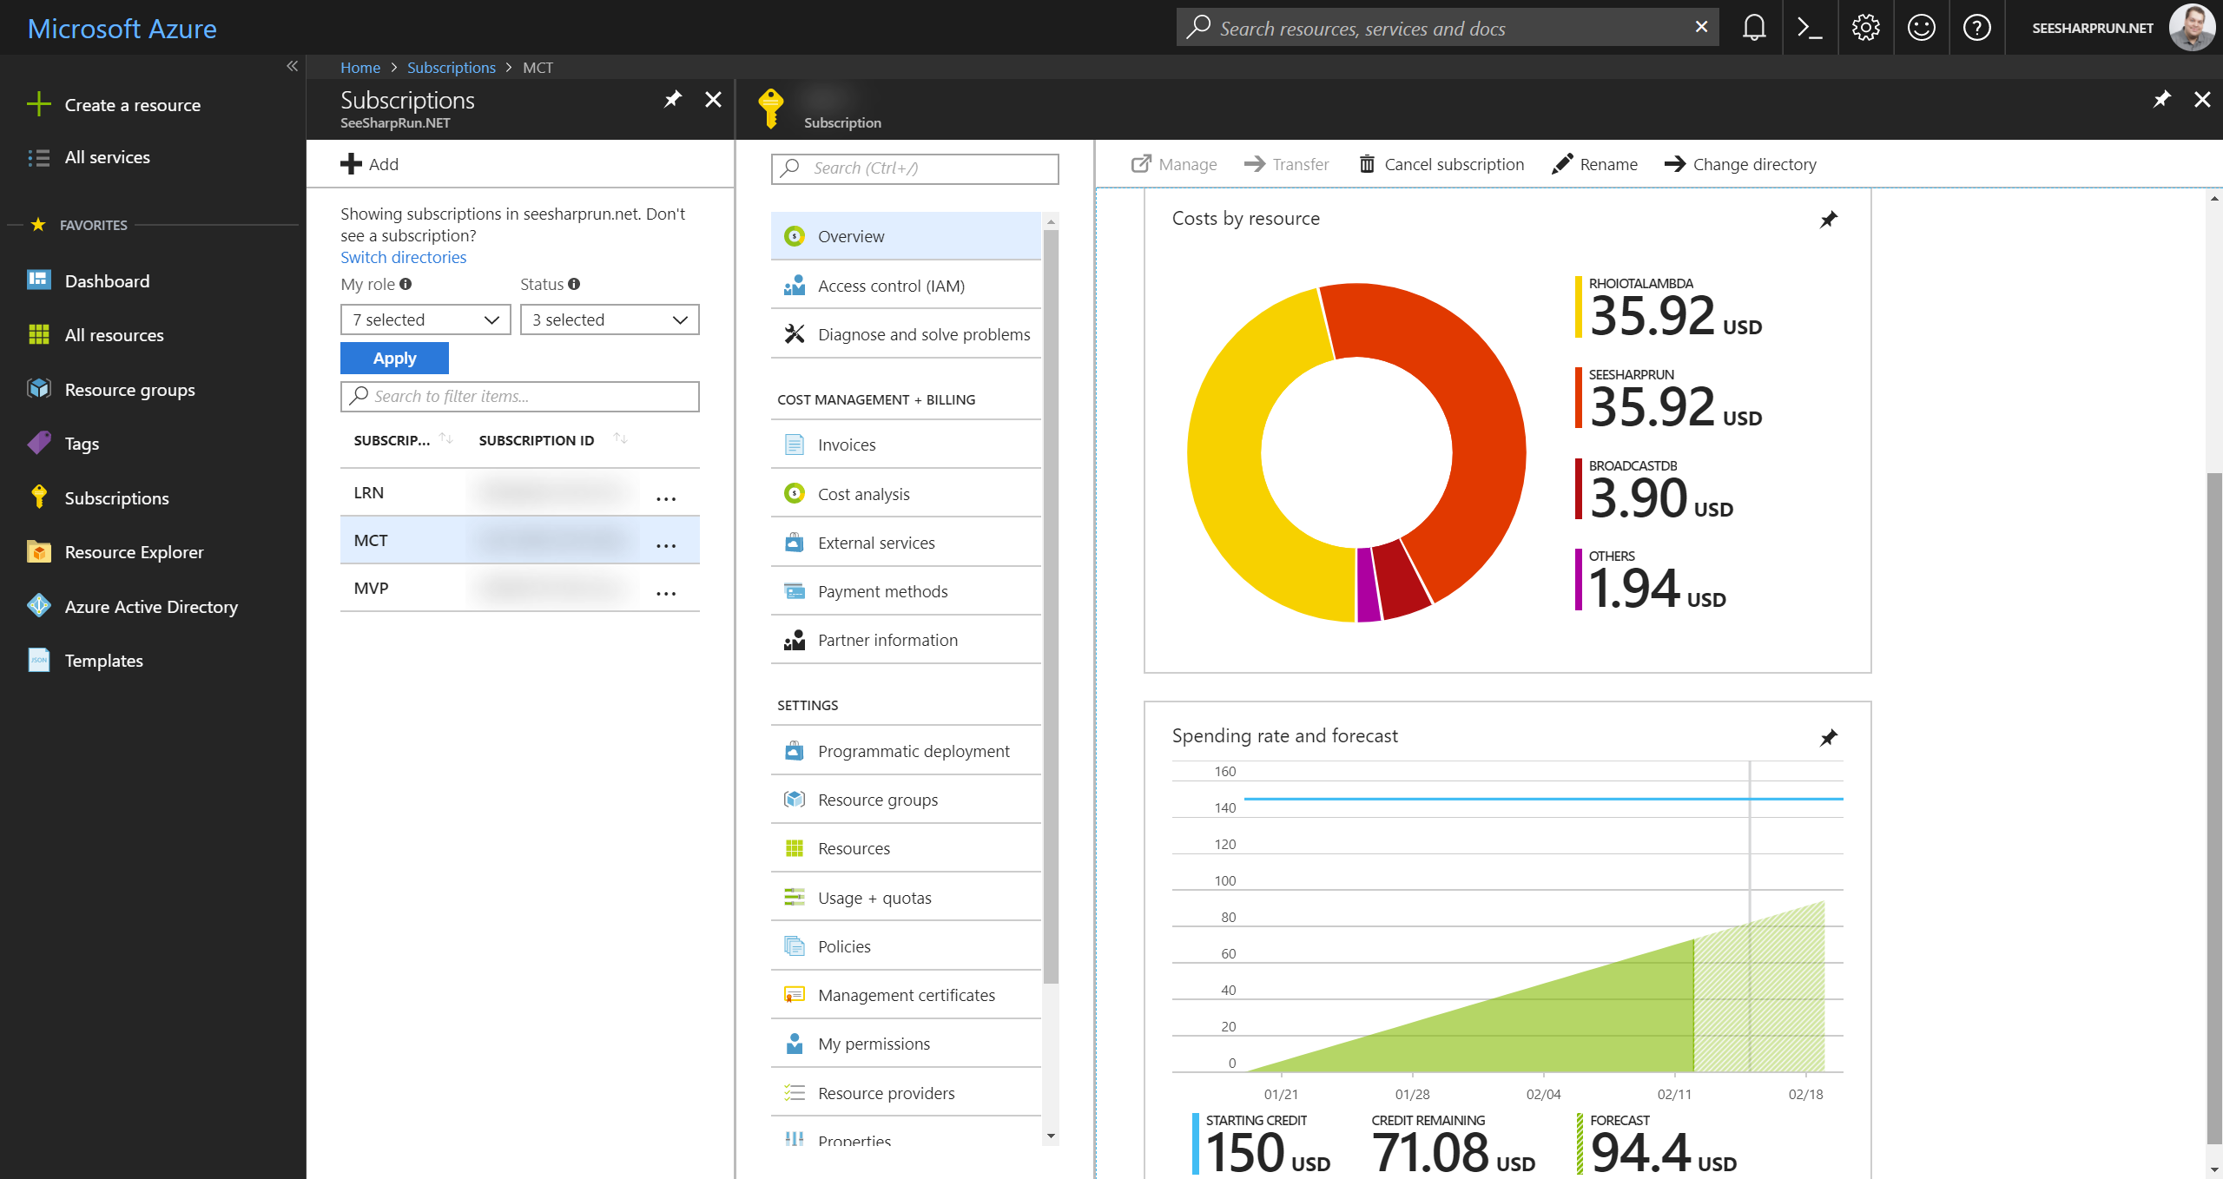
Management
Manage resources, subscriptions, access, and billing all in the same portal
Notes:
Billing
Previously, you had to switch from the Classic Portal to the Account Portal to view the billing data for your services. In the Portal, you can view the up-to-date billing data for your entire subscription in the form of
charts and infographics.
20532D
1: Overview of the Microsoft Azure Platform

Slide 30
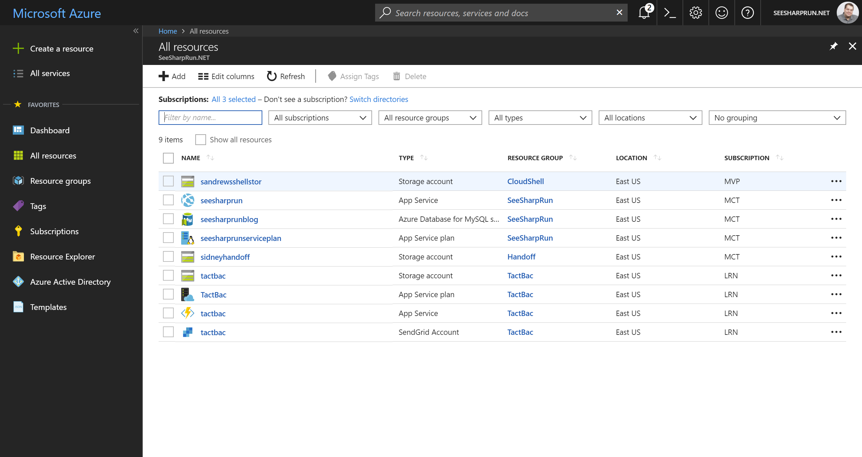
Resources
A Resource is an individual service instance
Notes:
20532D
1: Overview of the Microsoft Azure Platform

Slide 31
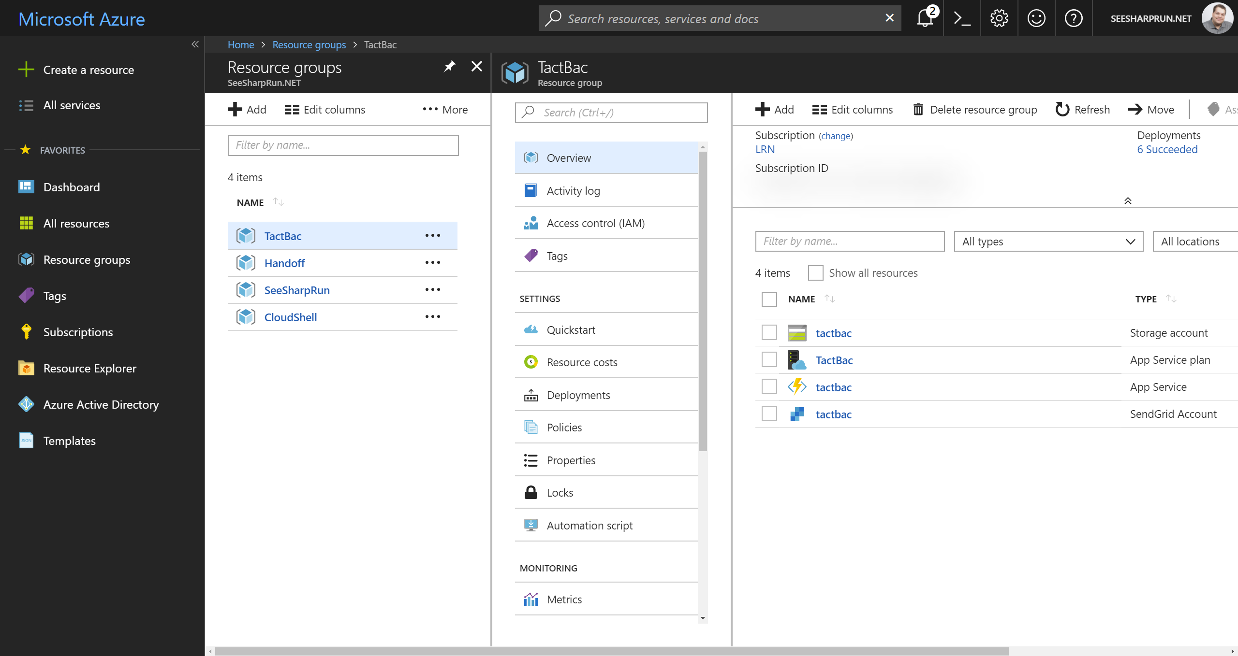
Resource Groups
A Resource Group is a unit of management for resources
Notes:
Lifecycle: Deployment, update, delete, status
Identity: Resources can talk to each other
Grouping: Metering, billing, quota: applied & rolled up to group
Resource Groups
Resource groups represent a new way of logically grouping your service instances. Service instances are known as resources and a collection of resources can exist in a resource group. By using resource groups,
you can view the metrics and billing data for a specific group in your subscription.
20532D
1: Overview of the Microsoft Azure Platform

Slide 32
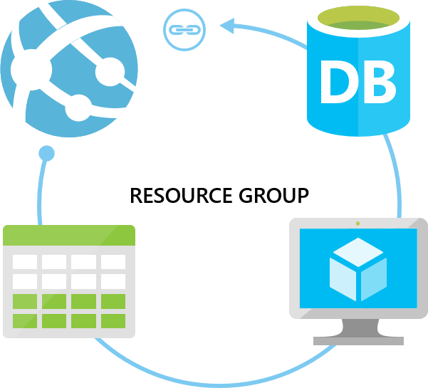
Resource Groups
Notes:
Container for multiple resources
Resources exist in one resource group
Resource groups can span regions
Resource groups can span services
20532D
1: Overview of the Microsoft Azure Platform

Slide 33
Portal Features
Create and configure cloud resources
Virtual machines, virtual networks, web apps, mobile apps, etc.
Monitor workloads and configure alerts
Customizable dashboard and blades
Integrated DevOps experience
Continuous integration and deployment and configuration management
Integration with the Azure Marketplace
Easy access to Microsoft and Azure certified solutions
Notes:
20532D
1: Overview of the Microsoft Azure Platform

Slide 34
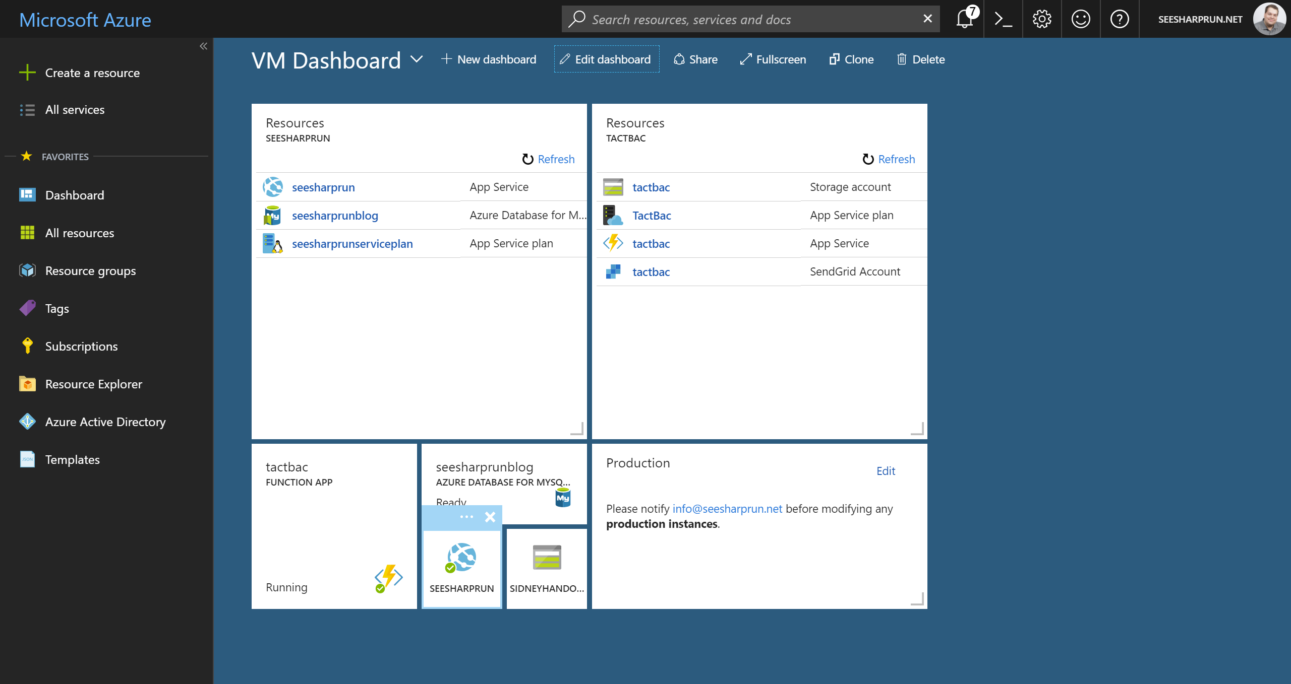
Dashboard
Notes:
Dashboard
The Dashboard is the first screen you see when you log on to the Portal. It is a collection of tiles that you can reorganize, resize, and remove. As you view the blades in your subscription, you can pin them to the
Dashboard so that you can return to them at a later point in time. You can also resize the tiles to emphasize specific data.
20532D
1: Overview of the Microsoft Azure Platform

Slide 35
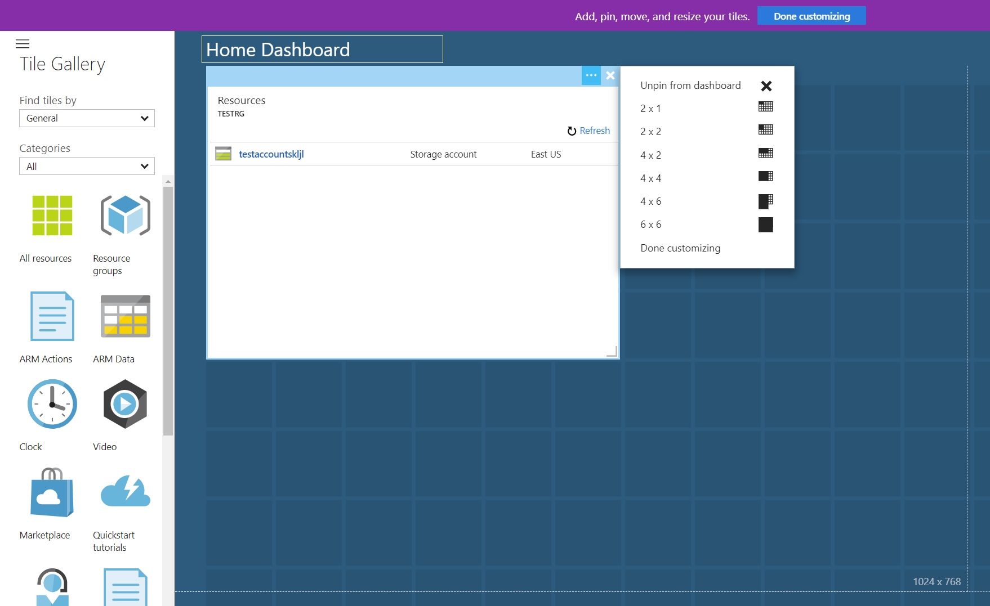
Customizing the Dashboard
Notes:
20532D
1: Overview of the Microsoft Azure Platform

Slide 36
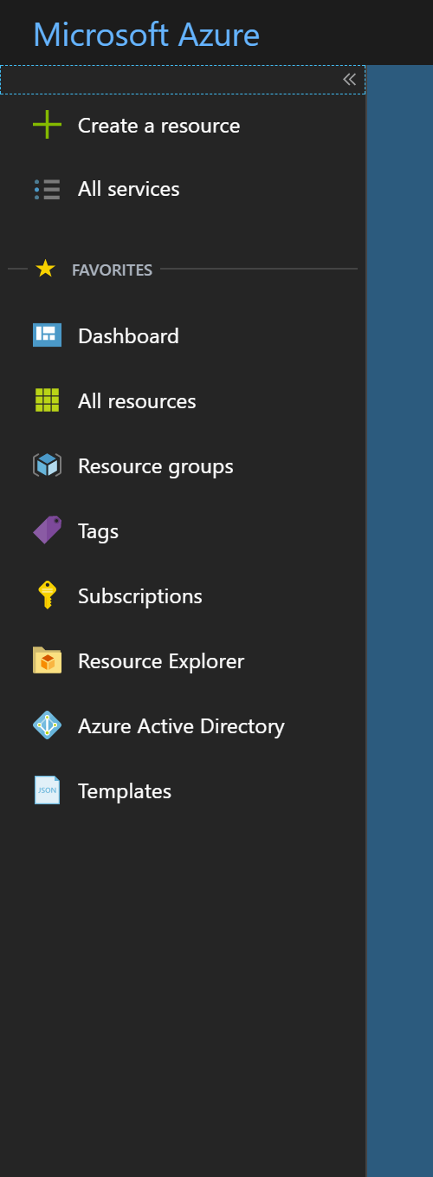
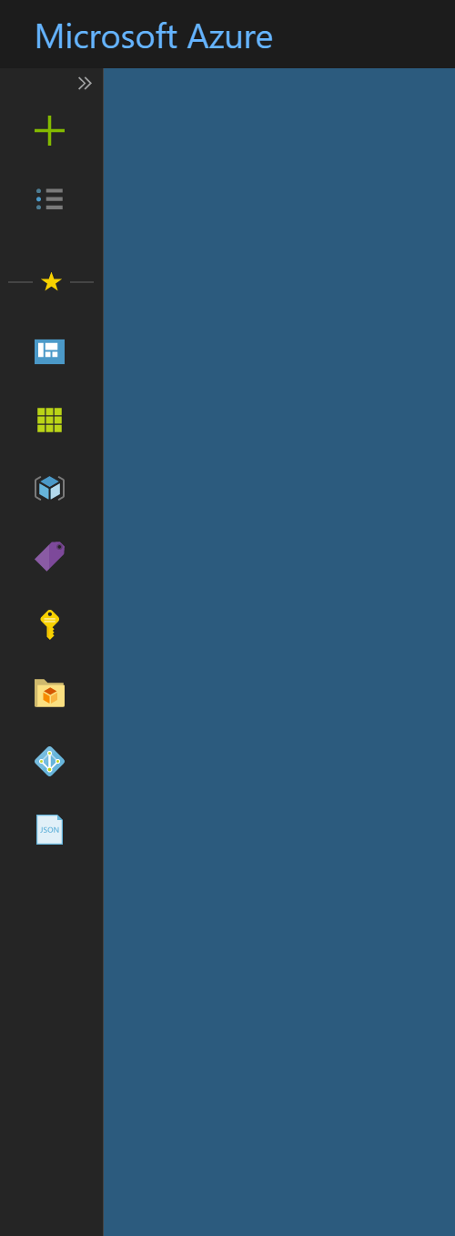
Navigation Menu
Expanded
Collapsed
Notes:
20532D
1: Overview of the Microsoft Azure Platform

Slide 37
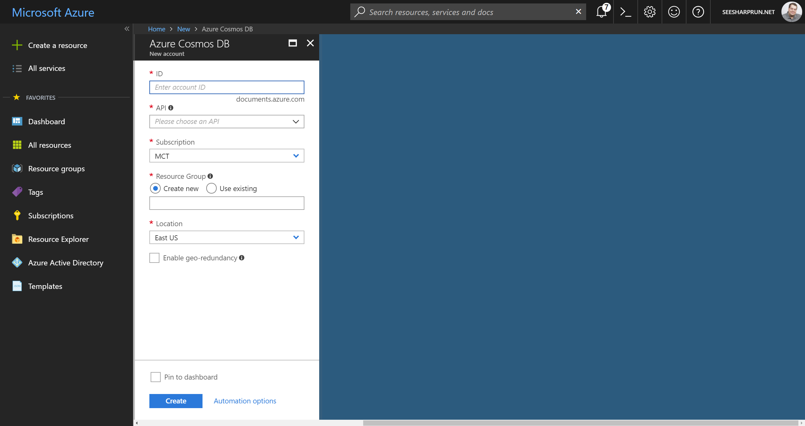
Blades
Notes:
Blades
When you view the settings for a service instance or take an action, the details are displayed in a vertical dialog box known as a blade. You can stack these blades horizontally so that you can
view the details of a service (or an action) and some of the follow-up actions without having to scroll horizontally. You can close a blade by clicking the close (X) button at the top-right corner.
20532D
1: Overview of the Microsoft Azure Platform

Slide 38
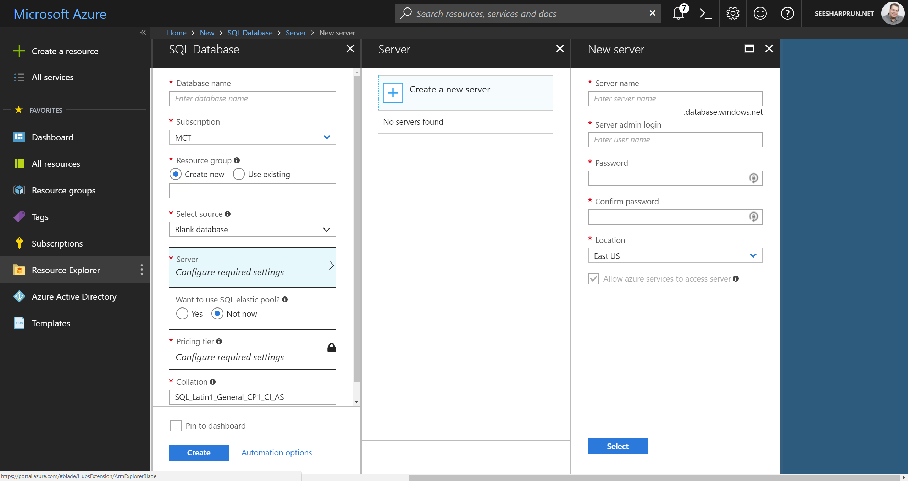
Journeys
Notes:
Journeys
Journeys are a collection of sequential blades that you can use to create or modify a service. For example, to create a Web App, you can go to the gallery blade, and then view the Web App gallery options blade.
After you select a specific Web App template, a blade describing the template displays. If you click Create, another blade displays with basic options for the new Web App. You could drill down further and specify
advanced options.
20532D
1: Overview of the Microsoft Azure Platform

Slide 39

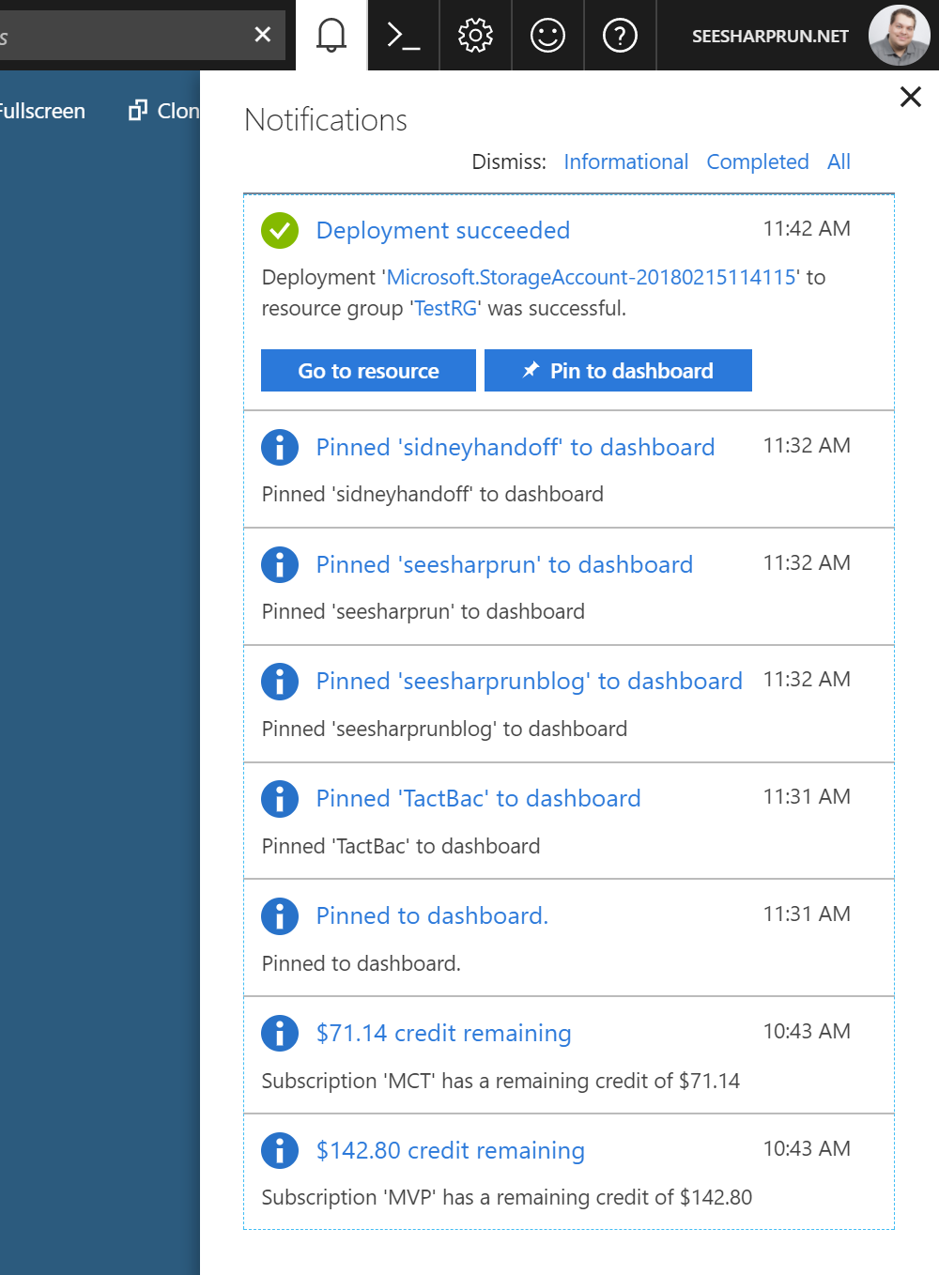
Notifications
In Progress
Completed
Notes:
20532D
1: Overview of the Microsoft Azure Platform

Slide 40
Demonstration: Using the Azure Portal
In this demonstration, you will learn how to:
Use the Azure Portal
Notes:
For this demonstration, you will use the available host machine. Before you begin this demonstration, you must complete the following step:
• Verify that you received the credentials to sign in to the Azure portal from your training provider. You will use these credentials and the Azure account throughout the labs in this course.
20532D
1: Overview of the Microsoft Azure Platform

Slide 41
Module 2
Building Application Infrastructure in Azure
Notes:
20532D
2: Building Application Infrastructure in Azure

Slide 42
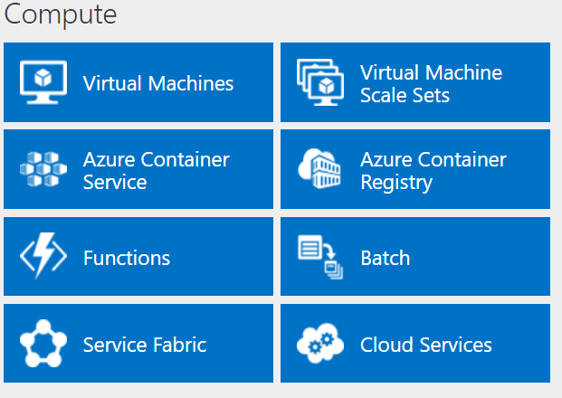
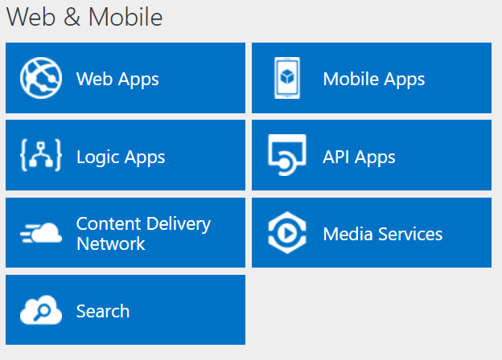
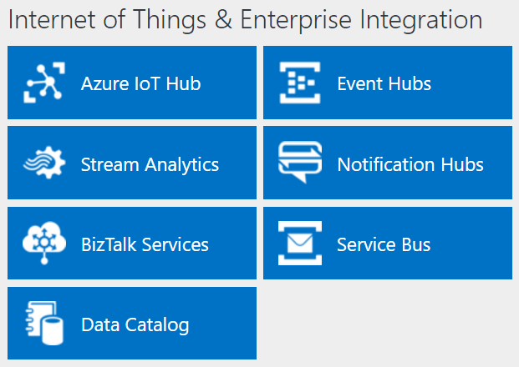
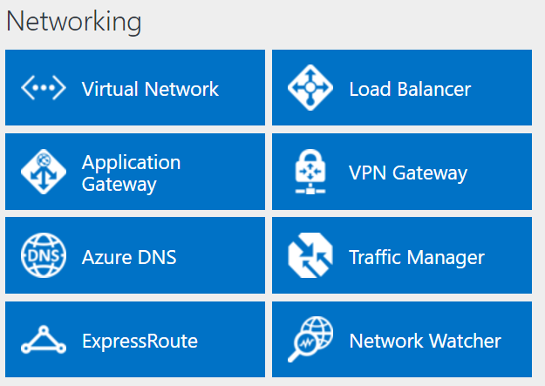
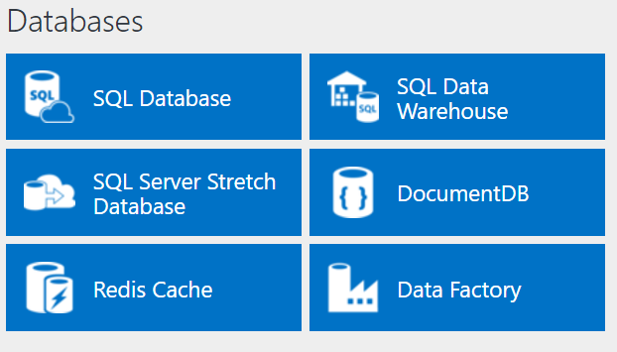
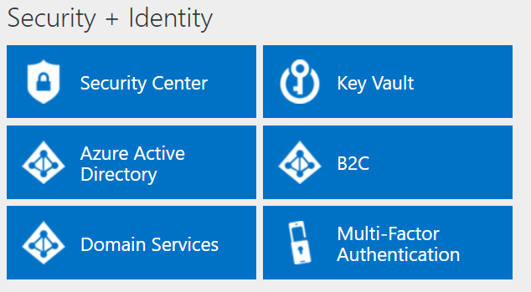
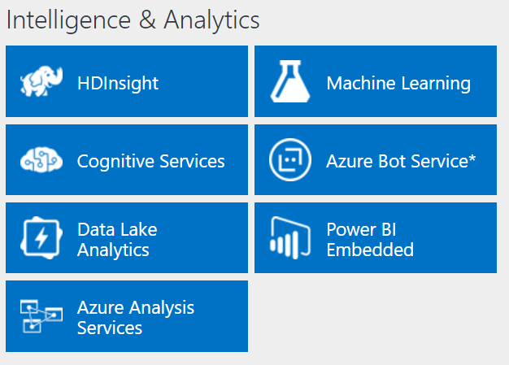
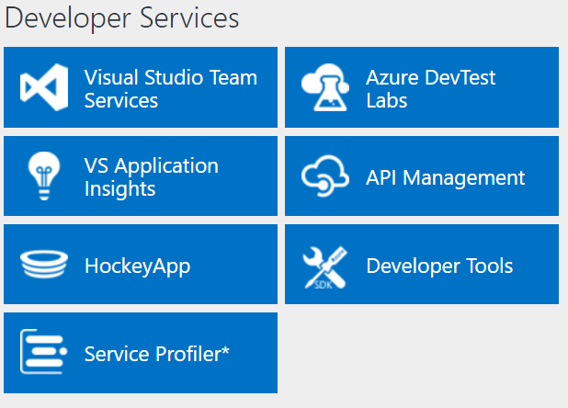
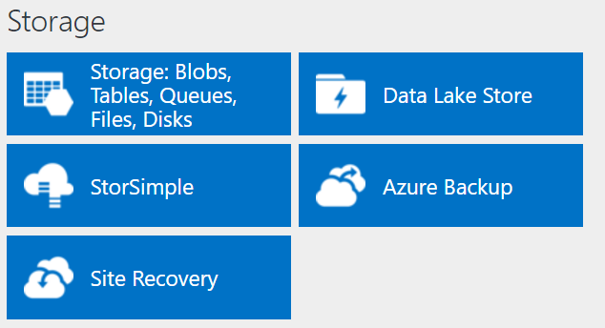
http://azureplatform.azurewebsites.net/
* Preview Services
Notes:
Preview Version 1.7 (2017-04-20)

Slide 43





Azure: The Power Of Choice
Compute
Virtual Machines
Container Service
Service Fabric
App Service
Functions
More Control
Focus on the App
Customer-managed
(IaaS)
Platform-managed
(PaaS)
Code-only
(serverless)
Notes:
Azure provides several cloud-based compute offerings to run your application so that you don't have to worry about the infrastructure details.
You can easily scale up or scale out your resources as your application usage grows. Azure offers services that cover the spectrum—from providing infrastructure-as-a-service (IaaS) to give you full control over your application hosting, through platform-as-a-service (PaaS) where the services are hosted for you, to true serverless hosting where all you need to do is write your code.

Slide 44
Module Overview
Azure Virtual Machines Azure Virtual Machine Workloads Migrating Azure Virtual Machine Instances Virtual Machine Configuration Management Customizing Azure Virtual Machine Networking
Notes:
Although many Microsoft Azure services use virtual machines, sometimes your application might have a unique need where it requires a virtual machine that is completely unmanaged. Azure provides networking, backup, and virtualization services as part of its Infrastructure-as-a-Service (IaaS) offering.
Lesson 1, “Azure Virtual Machines,” introduces the Virtual Machines service and describes the options that you can use for creating a virtual machine. Lesson 2, “Azure Virtual Machine Workloads,” provides details
on the types of workloads that you can deploy to a virtual machine. Lesson 3, “Migrating Azure Virtual Machine Instances,” describes the options for migrating virtual machines to and from Azure. Lesson 4,
“Highly Available Azure Virtual Machines,” reviews the options and features that must be considered when designing your Virtual Machine instances for high availability scenarios. Lesson 5, “Virtual Machine
Configuration Management,” describes the common methods for managing and duplicating the configuration for virtual machines. Lesson 6, “Customizing Azure Virtual Machine Networking,” reviews
the options for managing inbound and outbound connection rules for your virtual machine. Lesson 7, “Virtual Machine Scale Sets,” introduces the VMSS service and describes how it can be used to automatically provision virtual machines for autoscale scenarios.
Objectives
After completing this module, you will be able to:
• Describe the Virtual Machines service in Azure.
• Deploy a Linux or Microsoft workload to a virtual machine.
• Import virtual hard disks to Azure.
• Monitor virtual machine endpoints.
20532D
2: Building Application Infrastructure in Azure

Slide 45
Lesson 1: Azure Virtual Machines
Virtual Machines Overview Using Images to Construct Virtual Machines Demonstration: Creating a Virtual Machine
Notes:
The Virtual Machines service in Azure provides quick compute that can be scaled up or out and completely customized. The Azure Management Portal provides a large collection of templates that
makes it very easy for you to get started with a popular server operating system.
This lesson describes the Virtual Machines service in Azure and provides the details on some of its unique features.
Lesson Objectives
After completing this lesson, you will be able to:
• Describe the Virtual Machines service.
• Describe the prebuilt and custom image options.
20532D
2: Building Application Infrastructure in Azure

Slide 46
Virtual Machines Overview
Compute on demand
Compatible with Windows Server and Linux
Based on Hyper-V virtualization
You can transfer virtual hard disks between the cloud and your datacenter
Notes:
Virtual Machines Overview
Virtual Machines provides a highly flexible compute-on-demand option for running your application workloads. Azure Virtual Machines offer a variety of virtual machines sizes, compatibility with Windows and Linux and deep compatibility with Hyper-V fixed-size virtual hard disks.
Scale and Availability
Virtual machines in Azure can be grouped for high scalability and availability. By placing multiple virtual machines in a cloud service, you can stand up multiple instances of any tier of your application.
Hyper-V
Virtual machines in Azure use the well-known Hyper-V virtual hard disk format (.vhd) for their hard drives. Because Azure uses the .vhd format, you can simply upload fixed-size virtual hard disk files from your
existing infrastructure to Azure. You can also download virtual hard disk files from Azure to your datacenter.
20532D
2: Building Application Infrastructure in Azure

Slide 47
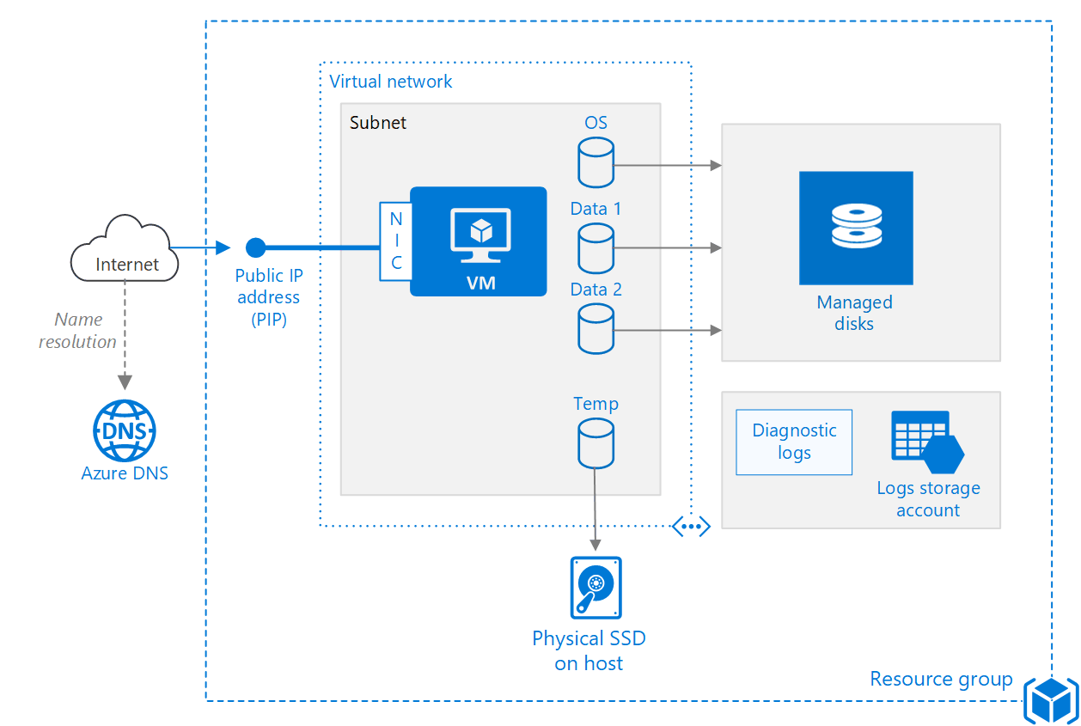
VM Composition
Notes:
Resources:
Public IP Address
Network Interface Card
Virtual Machine (CPU and Memory allocation)
One or more disks (managed or unmanaged)
Etc. (including extensions)
Typically grouped into Resource Group (students will see this in the demo)
20532D
2: Building Application Infrastructure in Azure

Slide 48
Using Images to Construct Virtual Machines
Many images are already provided by Microsoft:
Microsoft SQL Server
Microsoft SharePoint
OpenSUSE
Microsoft BizTalk Server
Your Azure subscription might have some custom images
For example, MSDN subscriptions come with Windows 7 and Windows 8.1 images with Microsoft Visual Studio preinstalled
Notes:
Using Images to Construct Virtual Machines
The Management Portal provides many images and scripting tools that help you to create new virtual machines in Azure. The template images that are available in the portal are created and fully supported by either Microsoft or an authorized third-party.
20532D
2: Building Application Infrastructure in Azure

Slide 49
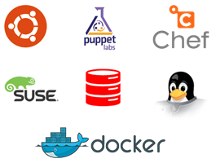
Using Images to Construct Virtual Machines
Open-source and third-party images are also available in the Management Portal
Notes:
20532D
2: Building Application Infrastructure in Azure

Slide 50
Using Images to Construct Virtual Machines
Existing virtual machines can have an image captured to use as a template for other virtual machines
Steps:
Use Remote Desktop to connect to a running virtual machine
Open an elevated instance of the command prompt application
Run the System Preparation Tool (Sysprep)
Use the Capture button in the Management Portal
Notes:
20532D
2: Building Application Infrastructure in Azure

Slide 51
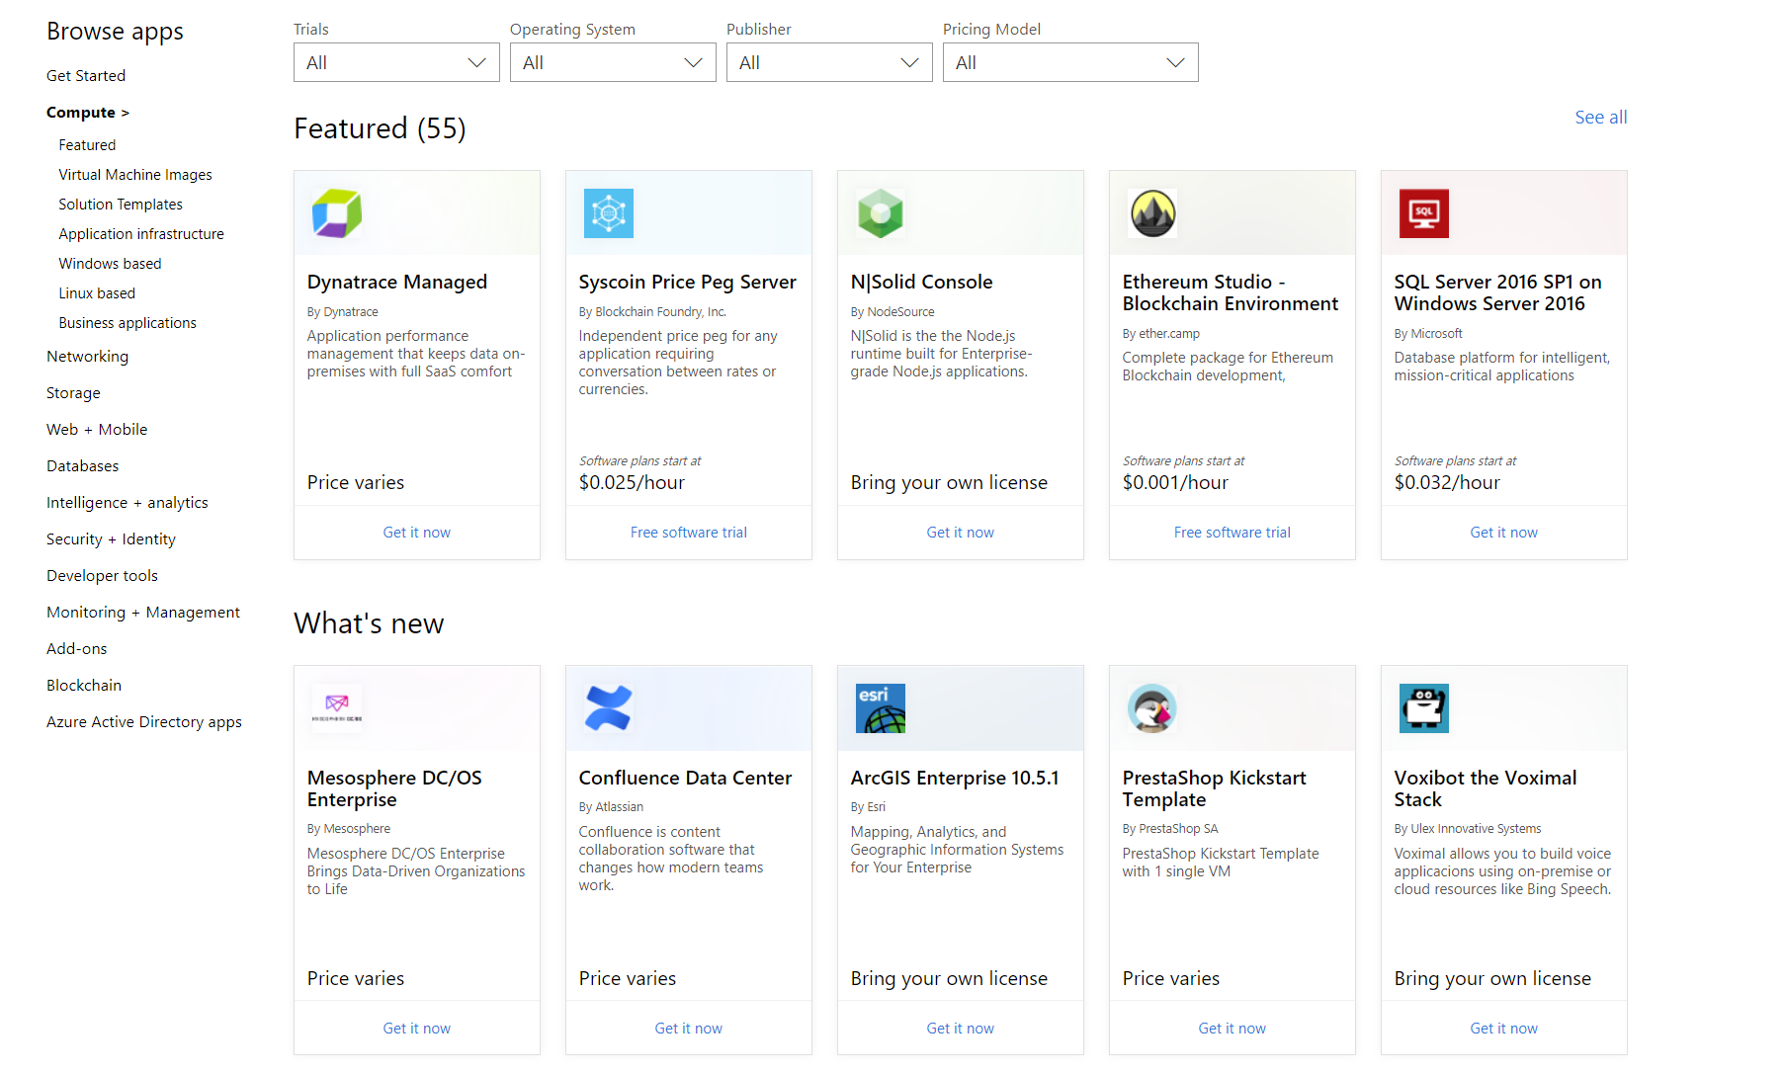
Azure Marketplace
Collection of third-party compute resources that can be deployed to an Azure subscription:
Cost varies based on the provider and software installed on the marketplace images
Many images offer “bring your own license” pricing
Notes:
https://azuremarketplace.microsoft.com/marketplace/apps/category/compute
20532D
2: Building Application Infrastructure in Azure

Slide 52
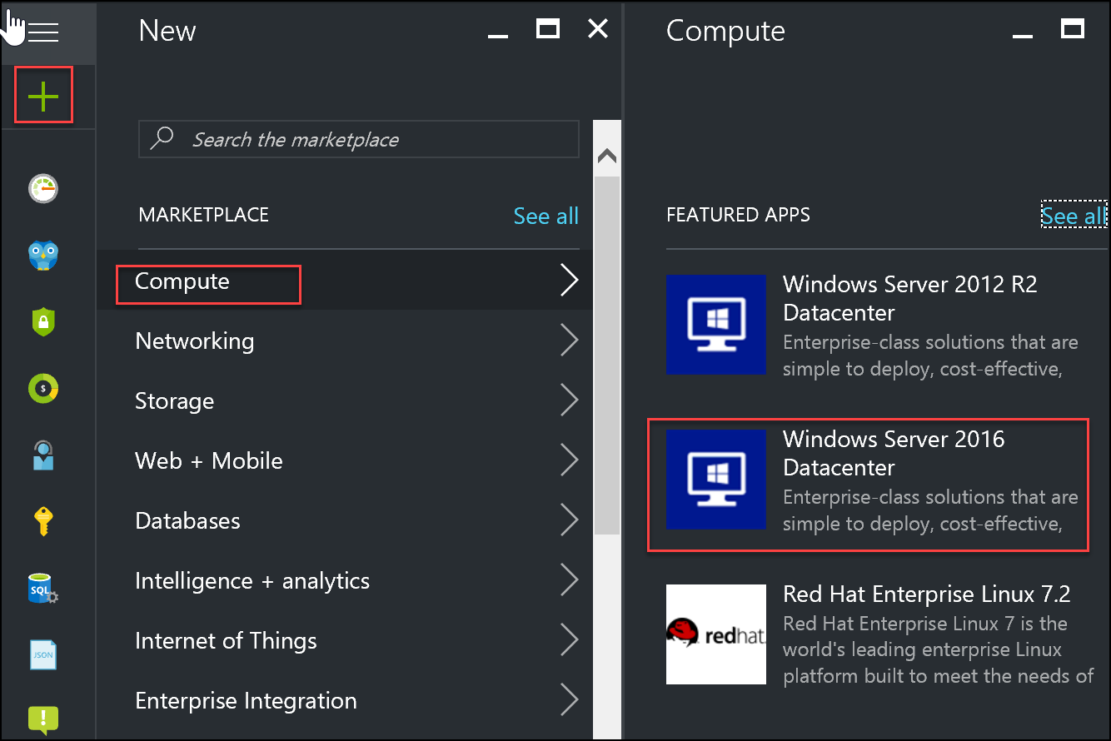
Using the Azure portal to create virtual machines
Notes:
Explain the process of creating a virtual machine by using the Azure portal.
20533D
3: Implementing virtual machines

Slide 53
Demonstration: Creating a Virtual Machine
In this demonstration, you will learn how to:
Create a virtual machine by using the Preview Portal
Use Remote Desktop to access the virtual machine
Notes:
Preparation Steps
Note: To view the latest demo steps, visit the GitHub repository for the course.
For this demonstration, you will use the available host machine. Before you begin this demonstration, you must complete the following step:
Verify that you received the credentials to sign in to the Azure portal from your training provider. You will use these credentials and the Azure account throughout the labs in this course.
20532D
2: Building Application Infrastructure in Azure

Slide 54
Lesson 2: Azure Virtual Machine Workloads
Windows Workloads Linux Workloads Virtual Machine Sizes
Notes:
You can deploy your existing application workloads to virtual machines in Azure that are running either on the Windows or Linux operating system.
This lesson describes some of the considerations for deploying application workloads to the virtual machines in Azure.
Lesson Objectives
After completing this lesson, you will be able to describe the key considerations for deploying Windows or Linux workloads to Azure.
20532D
2: Building Application Infrastructure in Azure

Slide 55
Windows Workloads
You can use virtual machines and virtual networks for many workload scenarios that mimic the way you structure enterprise on-premises applications
Examples:
Web Application
Web Server (IIS)
SQL Server
SharePoint
Web Front-Ends
SQL Server(s)
State Server
Application Services
Notes:
Windows Workloads
Many common Microsoft workloads (server software) are already supported in Azure. Most of these workloads also include corresponding virtual machine templates in the Azure portals.
Note: Virtual Machines using the Windows Server template include the cost of the Windows Server license. Virtual Machines created using a SQL Server or other Microsoft server software template are typically priced higher than virtual machines with just Windows Server installed. This is because the cost of the additional software license is added to the cost of the Windows Server license.
20532D
2: Building Application Infrastructure in Azure

Slide 56
Windows Workloads
Custom application workload on Azure Virtual Machines
Port 80
Web Application
IIS
IIS
SQL
SQL
SQL
Database
Notes:
This is a flexible slide. If the students have operations and IT Pro experience, you can discuss availability sets and SLA compliance. If the audience is does not have or care about operations, you can spend less time on this slide. This is a simple example of using virtual machines for a common IIS web server and SQL database server scenario.
20532D
2: Building Application Infrastructure in Azure

Slide 57
Linux Workloads
You can use the Linux–based virtual machines that are available in Azure to deploy common Linux workloads
Examples:
Apache Lucene
LAMP (Linux, Apache, MySQL, PHP)
Couchbase (distributed)
Drupal
Docker
Chef or Puppet
Docker
Notes:
Many common Linux distributions are already available on the Azure platform with gallery images. Including the images in VM Depot, there are enough images in the Azure platform to run the most popular Linux workloads.
The Azure platform provides a common interface for managing virtual machines, irrespective of whether they run on Linux or Windows. Many common features, such as capturing an image, attaching a disk, and stopping a virtual machine, use common buttons in either portal and common actions in the Cross-Platform Command-Line Interface.
20532D
2: Building Application Infrastructure in Azure

Slide 58
Virtual Machine Sizes
http://azure.microsoft.com/pricing/details/virtual-machines/
B-Series
D-Series
A-Series
G-Series
Notes:
Briefly show the current sizes for virtual machines using this site.
B-Series: Basic compute, give up features for cheaper hosting costs
D-Series & A-Series: Beneral purpose compute
G-Series: High memory-to-CPU ratio
Reference Links: http://go.microsoft.com/fwlink/?LinkID=525345
Most likely, the sizes have been updated since the time this content was published.
Virtual Machine Sizes
Virtual machines can be provisioned in a variety of sizes. These sizes provide a variety of options to customize the performance of your virtual machine such that it is adequate for your workload and also results in a cost-effective subscription.
20532D
2: Building Application Infrastructure in Azure

Slide 59
Virtual Machine Sizes
H-Series
L-Series
E-Series
NV-Series
Notes:
The number of sizes are constantly growing:
E-Series: High CPU-to-memory ratio
L-Series: Optimized for disk IO
NV-Series: Specialize VMs for GPU graphics rendering
H-Series: Most powerful machines with Remote Direct Memory Access (RDMA) for High-Performance Compute (HPC) workloads
20532D
2: Building Application Infrastructure in Azure

Slide 60
VM Sizes
Type | Sizes | Description
General purpose | B (Preview), Dsv3, Dv3, DSv2, Dv2, DS, D, Av2, A0-7 | Balanced CPU-to-memory ratio. Ideal for testing and development, small to medium databases, and low to medium traffic web servers.
Compute optimized | Fs, F | High CPU-to-memory ratio. Good for medium traffic web servers, network appliances, batch processes, and application servers.
Memory optimized | Esv3, Ev3, M, GS, G, DSv2, DS, Dv2, D | High memory-to-CPU ratio. Great for relational database servers, medium to large caches, and in-memory analytics.
Storage optimized | Ls | High disk throughput and IO. Ideal for Big Data, SQL, and NoSQL databases.
GPU | NV, NC | Specialized virtual machines targeted for heavy graphic rendering and video editing. Available with single or multiple GPUs.
High performance compute | H, A8-11 | Our fastest and most powerful CPU virtual machines with optional high-throughput network interfaces (RDMA).
Notes:
B series - https://buildazure.com/2017/09/11/more-affordable-azure-vms-with-burstable-b-series/
Determine Cores, RAM, ACUs, Disks, NICs, Network Speed, Temporary Storage, SSD support
High level categories:
Acu helps normalize cpu perf.. D&f have same acu

Slide 61
Lesson 6: Customizing Azure Virtual Machine Networking
Network Security Groups Firewall Rules VNET Connectivity
Notes:
Although you can use Azure virtual machines right after you create them, you must perform additional configuration before interfacing these virtual machines instances with external resources or other virtual
machines.
This lesson describes the methods used for customizing the network connectivity of an Azure virtual machine.
Lesson Objectives
After completing this lesson, you will be able to:
• Use custom endpoints to expose public ports for a virtual machine.
• Customize the access control list for a virtual machine or cloud service.
• Modify Windows Firewall in a virtual machine.
• View the public Virtual IP Address (VIP) for a virtual machine.
20532D
2: Building Application Infrastructure in Azure

Slide 62
http://azureplatform.azurewebsites.net/
* Preview Services
Notes:
20532D
6: Storing Unstructured Data in Azure

Slide 63
Network Interface Cards
Notes:
At the highest level, each Virtual Machine can have a Network Interface Card (NIC) that connects the VM to other resources using the internet (through a PIP), intranet (through an internal LB) or other endpoints.
20532D
2: Building Application Infrastructure in Azure

Slide 64
Azure virtual network connectivity options
Azure
West US VNet
East US VNet 1 East US VNet 2
VNet-to-VNet
VNet peering
ExpressRoute
Site-to-site
Point-to-site
On-premises network
Notes:
20532D
6: Storing Unstructured Data in Azure

Slide 65
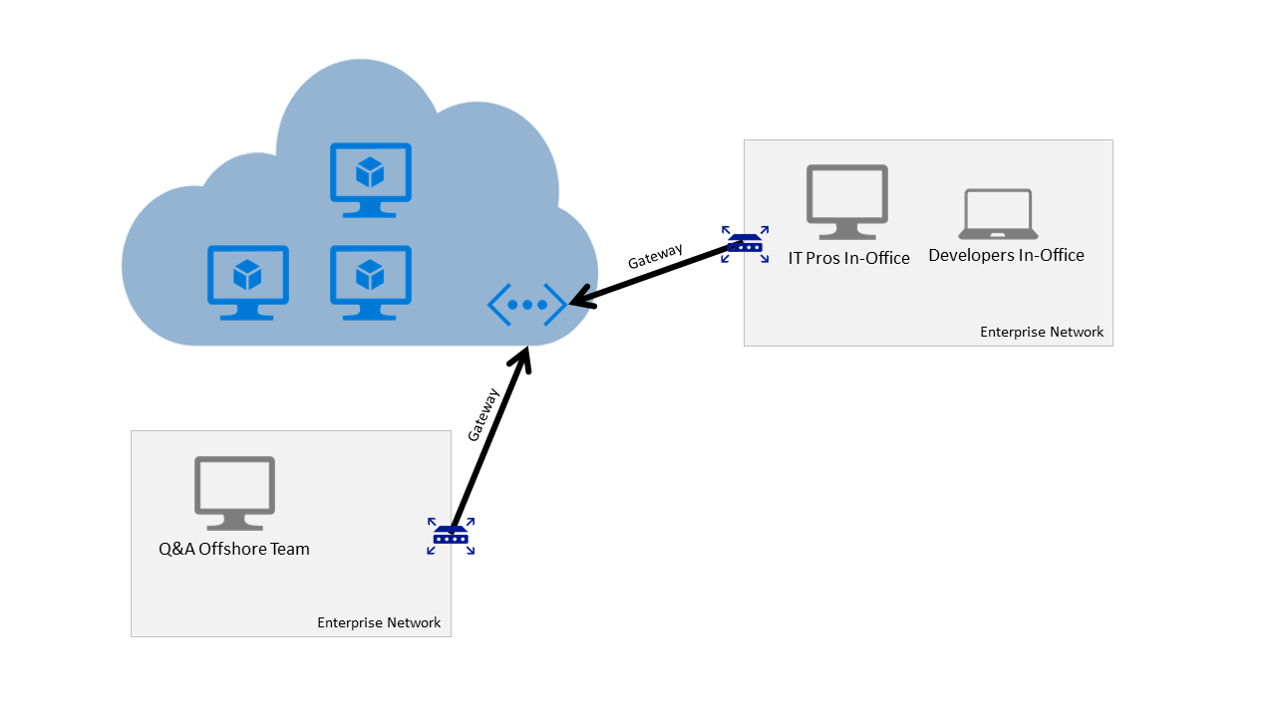
VNET Connectivity
Notes:
Site-to-Site
A site-to-site VPN allows you to create a secure connection between your on-premises site and your virtual network. To create a site-to-site connection, a VPN device that is located on your on-premises network is configured to create a secure connection with the Azure Virtual Network Gateway. Once the connection is created, resources on your local network and resources located in your virtual network can communicate directly and securely.
20532D
2: Building Application Infrastructure in Azure

Slide 66
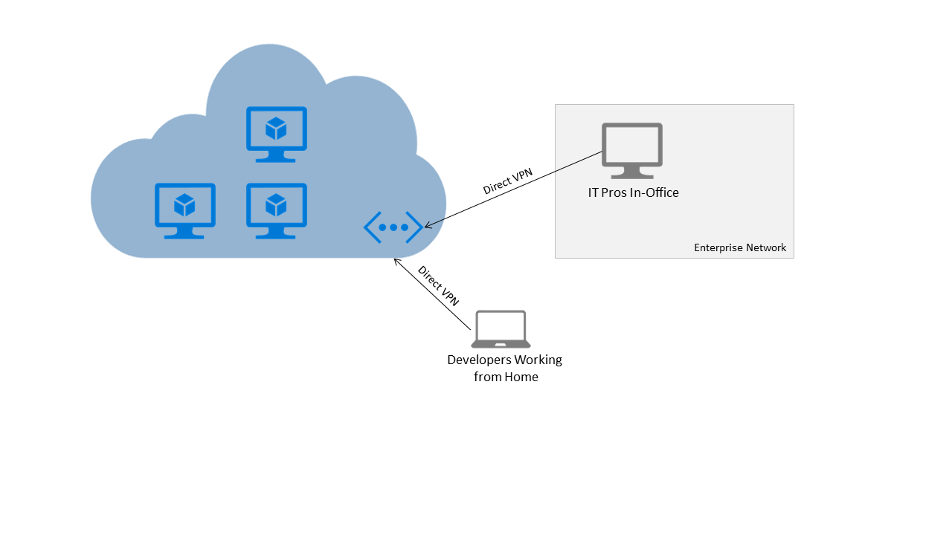
Point-to-Site
Notes:
Point-to-Site
A point-to-site VPN also allows you to create a secure connection to your virtual network. In a point-to-site configuration, the connection is configured individually on each client computer that you want to
connect to the virtual network. Point-to-site connections do not require a VPN device. They work by using a VPN client that you install on each client computer.
20532D
2: Building Application Infrastructure in Azure

Slide 67
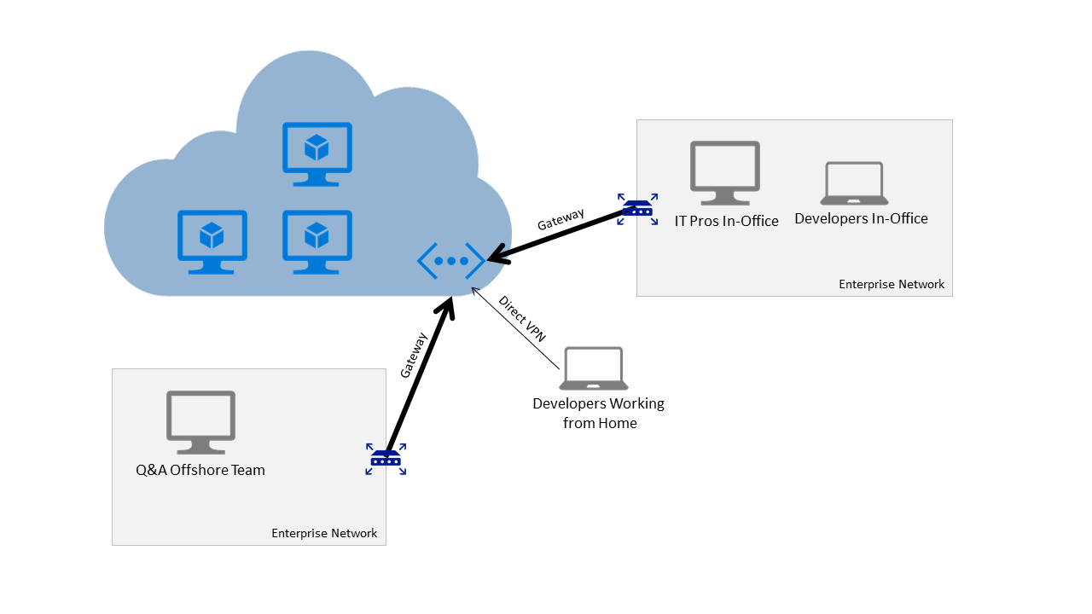
Mixing Point-to-Site and Site-to-Site
Notes:
20532D
2: Building Application Infrastructure in Azure

Slide 68
Virtual network connectivity
Cross-premises:
Point-to-Site
Site-to-Site
ExpressRoute
Cross-virtual network:
VNet peering - the same Azure region
VNet-to-VNet - different Azure regions
Virtual gateways:
VPN gateways
ExpressRoute gateways
Notes:
20532D
6: Storing Unstructured Data in Azure

Slide 69
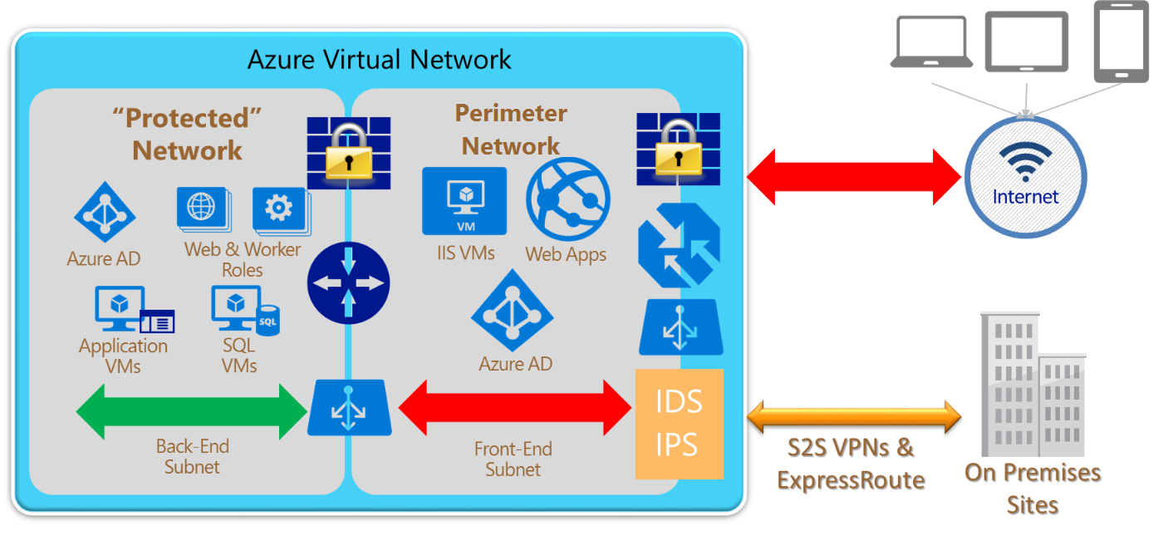
Azure Virtual Network
Notes:
20532D
6: Storing Unstructured Data in Azure

Slide 70
Network Security Groups
Specify granular access control at an endpoint level:
Network Interface Card
Subnet
If applied to Subnet, every compute resource in the subnet “inherits” the rules from the NSG
NSGs are resources themselves:
Can be applied, removed, and re-applied to an endpoint
Can be created and deleted separately from VMs and endpoint resources
Notes:
If your group has advanced networking knowledge, you can discuss how you can secure requests using Permit and Deny over IP ranges.
Network Security Groups
An NSG works on one or more VM instances and controls all the traffic that is inbound and outbound.
You can associate an NSG to a VM, or to a subnet within a VNet. When associated with a VM, the NSG applies to all the traffic that is sent and received by the VM instance.
20532D
2: Building Application Infrastructure in Azure

Slide 71
Default NSG Inbound Rules
NAME | PRIORITY | SOURCE IP | SOURCE PORT | DESTINATION IP | DESTINATION PORT | PROTOCOL | ACCESS
ALLOW VNET INBOUND | 65000 | VIRTUAL_ NETWORK | * | VIRTUAL_ NETWORK | * | * | ALLOW
ALLOW AZURE LOAD BALANCER INBOUND | 65001 | AZURE_ LOADBALANCER | * | * | * | * | ALLOW
DENY ALL INBOUND | 65500 | * | * | * | * | * | DENY
Notes:
20532D
2: Building Application Infrastructure in Azure

Slide 72
Default NSG Outbound Rules
NAME | PRIORITY | SOURCE IP | SOURCE PORT | DESTINATION IP | DESTINATION PORT | PROTOCOL | ACCESS
ALLOW VNET OUTBOUND | 65000 | VIRTUAL_ NETWORK | * | VIRTUAL_ NETWORK | * | * | ALLOW
ALLOW INTERNET OUTBOUND | 65001 | * | * | INTERNET | * | * | ALLOW
DENY ALL OUTBOUND | 65500 | * | * | * | * | * | DENY
Notes:
20532D
2: Building Application Infrastructure in Azure

Slide 73
Firewall Rules
Just like with many on-premises Windows machines, virtual machines in Azure have an instance of Windows firewall running
Adding an endpoint is the first step in granting access to a port on your virtual machine instance:
External Resources
Inbound request for port 85
Azure Load Balancer
Receives request on public port 85
Windows Firewall
Allows or denies inbound request for port 80
Verifies request with ACL
Redirects request to private port 80
Notes:
Windows Firewall is a built-in, host-based, stateful firewall that is included in the client version of Windows and Windows Server. Windows Firewall drops incoming traffic that does not correspond to either the traffic that is sent in response to a request of the computer (solicited, outbound traffic) or unsolicited traffic that has been specified as allowed (excepted, inbound traffic). Windows Firewall is configured by using the Windows Firewall with Advanced Security snap-in, which integrates rules for both firewall behavior and traffic protection with Internet Protocol security (IPsec).
20532D
2: Building Application Infrastructure in Azure

Slide 74
Load balancers
Azure Load Balancer:
Internal load balancer
Direct server return
Internet-facing load balancer
To configure:
Assign a front-end IP
Public for an Internet-facing load balancer
Private for an internal load balancer
Assign back-end address pool
Create load-balancing rules
Create inbound NAT rules (optional)
Create health probes
Application Gateway
Traffic Manager
Notes:
20532D
6: Storing Unstructured Data in Azure

Slide 75
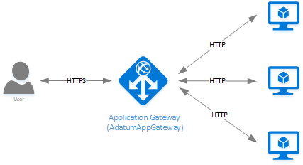
Application Gateway
Notes:
20532D
6: Storing Unstructured Data in Azure

Slide 76
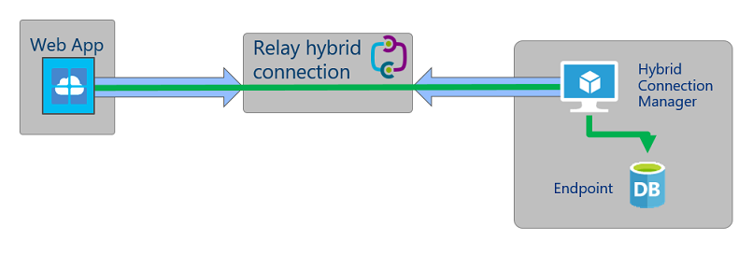
Hybrid Connectivity
https://docs.microsoft.com/en-us/azure/app-service/app-service-hybrid-connections
Notes:
20532D
6: Storing Unstructured Data in Azure

Slide 77
Lab: Creating an Azure Virtual Machine for Development and Testing
Exercise 1: Creating a Network and Resource Container Exercise 2: Creating a Development Virtual Machine Exercise 3: Configuring the Virtual Machine for Development
Notes:
You can alternatively have the students create a VM using the Visual Studio 2013 or 2015 templates. This will help in scenarios where a student fails to complete the lab but the class must move on to later modules. Modules 3-13 requires Module 2 to be completed before beginning their labs as the Virtual Machine created in this lab is the lab environment for those modules.
Exercise 1: Creating a Network and Resource Container
Exercise 2: Creating a Development Virtual Machine
Exercise 3: Configuring the Virtual Machine for Development
20532D
2: Building Application Infrastructure in Azure

Slide 78
Module 3
Hosting Web Applications on the Azure Platform
Notes:
20532D
3: Hosting Web Applications on the Azure Platform

Slide 79
http://azureplatform.azurewebsites.net/
* Preview Services
Notes:
Preview Version 1.7 (2017-04-20)

Slide 80
Module Overview
Azure Web Apps Configuring an App Service App Publishing an Azure App Service App
Notes:
This module provides an overview of the Azure Web Apps service. Lesson 1, “Azure Web Apps,” introduces the Azure App Service platform-as-a-service offering available in Azure and specifically focuses on the
Web Apps feature of App service. Lesson 2, “Azure Logic and Function Apps,” explore two of the types of apps available in Azure App Service. Lesson 3, “Configuring an App Service App,” discusses the various
configuration options available to change the behavior of your app. Lesson 4, “Publishing an App Service App,” describes the process for publishing a web application to an app. Lesson 5, “Supplemental Services,”
introduces additional service offerings for web applications in Azure such as the intelligent service offerings and the API Management service that can be used as a proxy to an App Service app.
Objectives
After completing this module, you will be able to:
• Create a Web App instance.
• Publish a simple ASP.NET web application to Web Apps.
• Monitor a Web App instance.
• Use additional Azure services with a Web App instance.
• Use Function and Logic Apps to create an integration workflow.
20532D
3: Hosting Web Applications on the Azure Platform

Slide 81
Lesson 1: Azure Web Apps
Azure Web Apps Overview Web App Tiers Prebuilt Web App Templates Demonstration: Creating a Web App Web App Configuration App Service Plans
Notes:
In many scenarios, it is preferable to use a quick and easy way to deploy web applications to the cloud rather than to reengineer the web applications as cloud projects. Web Apps allow you to quickly create a
new Web App and iterate changes to the Web App in an agile manner. This lesson describes the Web Apps service.
Lesson Objectives
After completing this lesson, you will be able to:
• Describe the Web Apps service.
• List the different tiers for a Web App.
20532D
3: Hosting Web Applications on the Azure Platform

Slide 82
Azure Web Apps Overview
Simple, scalable hosting for websites in Windows Azure with the following benefits:
Provides a quick way to host your web application in the cloud
Allows you to scale your web app without being required to redesign for scalability
Integrates with Visual Studio
Provides an open platform for many different programming languages
Notes:
Emphasize how simple it is to deploy a web application to Azure Web Apps.
You can also talk about what scalability means with respect to a Web App in Azure. Unlike with cloud services, you can easily scale the number of instances and the size of a Web App without having to redesign your web application to make it completely modular.
Azure Web Apps Overview
Web Apps is a low friction Platform-as-a-Service (PaaS) offering to host your web applications in the Azure platform. The service is fully managed and you can easily configure advanced features such as AlwaysOn, custom domains, and autoscale by using either portal.
Flexibility
You can use a variety of integrated development environments (IDEs) and frameworks, such as .NET, Java, PHP, Node.js, or Python, to develop your web applications that are eventually deployed to Azure Web Apps.
Scalability
Because Web Apps is a fully managed service implementation, you can focus on developing your application and solving business problems instead of the hosting implementation and hardware scaling or specifics.
20532D
3: Hosting Web Applications on the Azure Platform

Slide 83
Web App Tiers
Web Apps can be scaled to run in one of the following modes:
Free
Shared
Shared compute resources
No upper limit to bandwidth and CPU time
Additional customization options
Limited customization options
Limited bandwidth and CPU time
Shared compute resources
Notes:
How to Scale Web Apps:
Reference Link: http://go.microsoft.com/fwlink/?LinkID=510177
When you use the Standard Web App tier, you can host multiple Web Apps under the same compute instance. In this case, you are charged by the number of instances instead of the number of Web Apps. The Standard tier also comes with a Service Level Agreement (SLA) of 99.9% monthly uptime.
Web App Tiers
The Web Apps service is available in four tiers:
Free, Shared, Basic, and Standard. You can use App Service Plans to assign a tier to a group of Web App instances. At any time, you can switch the tier for a App Service Plan.
The Free tier offers 10 free Web App instances. All the instances share pool of60 minutes of CPU time per day. The free tier also enforces an outbound data limit of 165 megabytes (MB) per day.
The Shared tier has a lot in common with the Free tier, but many restrictions are relaxed. For example, the Outbound Data limit is removed and each instance is allowed 240 minutes of CPU time per day that is not
pooled. You can also have up to 100 Web App instances in this tier.
20532D
3: Hosting Web Applications on the Azure Platform

Slide 84
Web App Tiers
Web Apps can be scaled to run in one of the following modes:
Basic
Reserved instance for multiple web applications
Websites are pooled under the same instance
Standard
Reserved instance for multiple web applications
Websites are pooled under the same instance
Supports auto-scale
Notes:
In the Basic tier, your Web App instances are not in a shared environment. Instead, you have a dedicated compute instance where you can host as many Web App instances as you want. In addition to the
features offered by the Free and Shared tiers, this tier also supports AlwaysOn, Secure Socket Layer (SSL) for custom domains, and a limited quantity of WebSocket connections (350 per Web App).
The Standard tier offers the same functionality as the Basic, Free and Shared tiers, but includes additional features such as Publishing Slots and Backups. With the auto-scale functionality, you can automatically
scale your Web App based on a metric or a schedule.
20532D
3: Hosting Web Applications on the Azure Platform

Slide 85
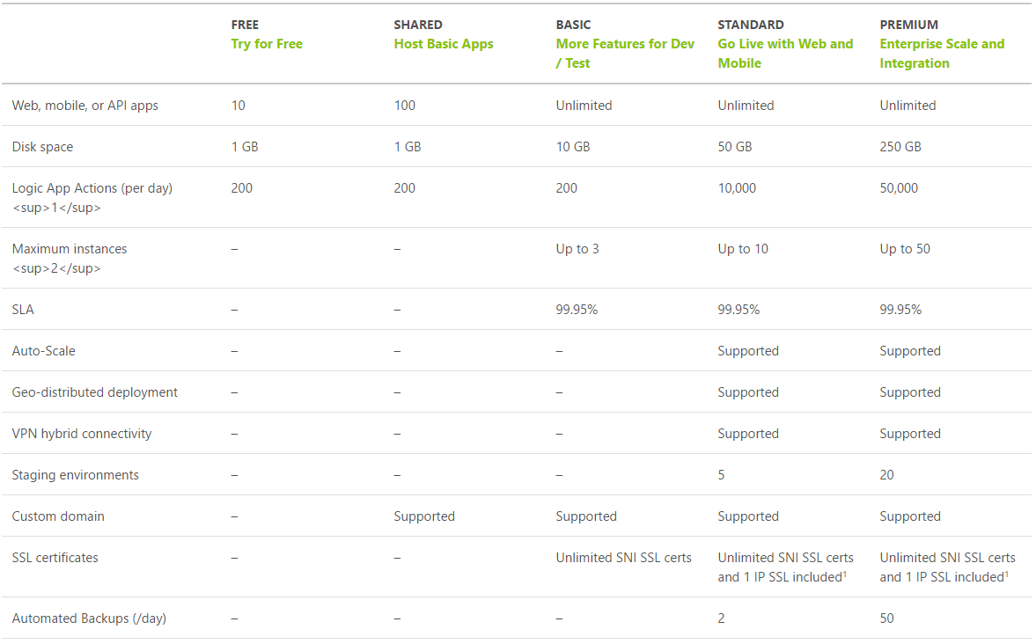
App Service Plan Tiers
https://azure.microsoft.com/en-us/pricing/details/app-service/plans/

Slide 86
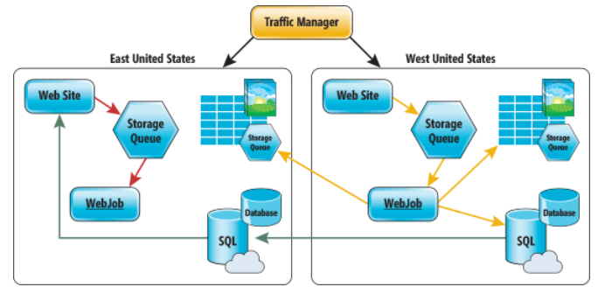
Deploy Azure Web Apps to Multiple Regions
Traffic Manager for routing traffic between regions
Performance – for directing user to closest region Failover – for secondary site Round Robin – for balancing traffic
CDN
Places static content close to user (images, media, etc.)
Notes:
Deploy Azure Web Apps to Multiple Regions for High Availability
Controlling Azure web app traffic with Azure Traffic Manager
https://docs.microsoft.com/en-us/azure/app-service-web/web-sites-traffic-manager
Add a Content Delivery Network (CDN) to an Azure App Service
https://docs.microsoft.com/en-us/azure/app-service-web/app-service-web-tutorial-content-delivery-network
Best Practices: Windows Azure Websites (WAWS)
https://azure.microsoft.com/en-us/blog/best-practices-windows-azure-websites-waws/

Slide 87
Web App Tiers
To host multiple Web Apps, use a Standard or Basic Web Hosting Plan:
Reserves a virtual machine for your websites
Billed based on number of virtual machine instances and not number of websites
Standard
Basic
Shared
Free
Notes:
For simple Web Apps, you might overestimate the number of instances and the size that is required. Mention that it is possible to host many Web Apps instances in a single small size Standard App Service Plan. This is a common tactic to save on hosting costs.
20532D
3: Hosting Web Applications on the Azure Platform

Slide 88
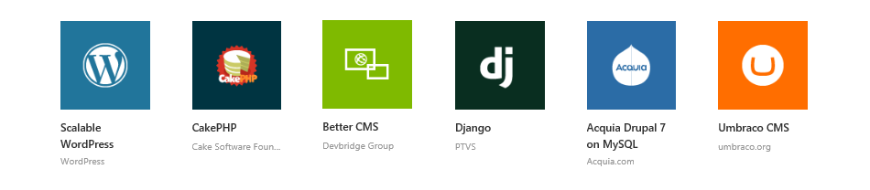
Prebuilt Web App Templates
Create a Web App using a prebuilt template from the Azure Marketplace
There are over 30 open-source applications, frameworks, and templates in the Marketplace:
Notes:
Most of the applications that are available in the Windows Web App Gallery () are also available in Microsoft Azure Marketplace.
20532D
3: Hosting Web Applications on the Azure Platform

Slide 89
Demonstration: Creating a Web App
In this demonstration, you will learn how to:
Create a Web App instance by using the Azure Portal
Create a SQL Database instance by using the Portal
Manage the Web App and SQL Database instances as a Resource Group
Notes:
Preparation Steps
Note: The demo steps are accurate as of the publishing date of this course. To view the latest demo steps, visit the GitHub repository for the course.
For this demonstration, you will use the available host machine. Before you begin this demonstration, you must complete the following step:
Verify that you received credentials to sign in to the Azure portal from your training provider. You will use these credentials and the Azure account throughout the labs in this course.
20532D
3: Hosting Web Applications on the Azure Platform

Slide 90
Web App Configuration
The Web App deployment package and its configuration are both stored in an external store
App Settings and Connection Strings are intercepted and changed in the application during startup
Applications can be scaled by:
Creating IIS websites using the Web Deploy package
Applying configuration options from the external store
Notes:
Kudu is the engine behind most of the enhanced features that are offered by Web Apps. Kudu can also be used with your local web application projects. The Kudu project is an open-source
project that is available on GitHub, and it supports many features such as:
• Web application publishing from a source control system
• Deployment hooks
• Web hooks
• Web Jobs
20532D
3: Hosting Web Applications on the Azure Platform

Slide 91
Web App Configuration
Web Apps share functionality with IIS websites:
For Free and Shared instances, websites are implemented similar to IIS websites
For Standard instances, a reserved virtual machine is made available and each individual website is similar to an IIS website
Azure Websites can also be managed remotely using the IIS Manager
Notes:
20532D
3: Hosting Web Applications on the Azure Platform

Slide 92
App Service Plan
Represents the collection of physical resources used to host your apps
Region (West US, East US, etc.)
Scale count (one, two, three instances, etc.)
Instance size (Small, Medium, Large)
SKU (Free, Shared, Basic, Standard, Premium)
Web Apps, Mobile Apps, API Apps, Functions run in an App Service Plan
Notes:
Create App Service Plans
Azure App Service plans in-depth overview
https://docs.microsoft.com/en-us/azure/app-service/azure-web-sites-web-hosting-plans-in-depth-overview?toc=%2fazure%2fapp-service-web%2ftoc.json

Slide 93
App Service Plans
App Service Plans can logically group Web Apps within a subscription:
Characteristics such as features, capacity, and tiers are shared among the website instance in the group
Multiple App Service Plans can exist in a single Resource Group and multiple Web Apps can exist in a single App Service Plan
Notes:
You can suggest this article to students who want to dive deeper into App Service Plans.
Reference Link: http://go.microsoft.com/fwlink/?LinkID=510178
You can group your Web App instances so that the capacity can be shared among them. At any given time, a Web App instance can only be associated with a single App Service Plan. A single Resource Group can contain multiple App Service Plans.
20532D
3: Hosting Web Applications on the Azure Platform

Slide 94
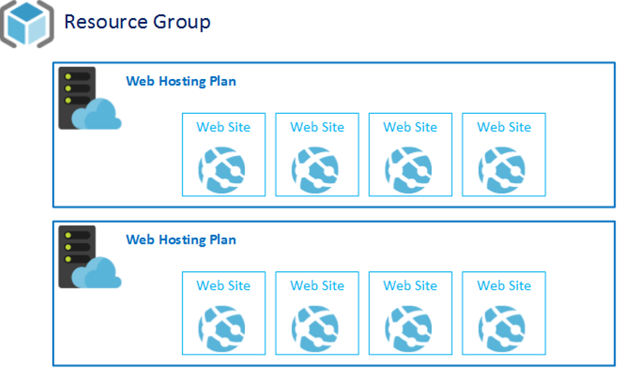
App Service Plans
App Service Plan
App Service Plan
Notes:
20532D
3: Hosting Web Applications on the Azure Platform

Slide 95
App Service Plans
App Service Plans are a required parameter when creating a new Web App instance
You can chose to add a new Web App to an existing plan
You can also define a new App Service Plan as a part of creating a new Web App
Notes:
20532D
3: Hosting Web Applications on the Azure Platform

Slide 96
App Service on Linux
Why Linux?
Many application stacks are optimized for Linux:
Ruby/Rails, PHP, Node, etc.
Often better tools are available on Linux for these stacks
New and upcoming frameworks are built for Linux first and then Windows
Portability of Docker containers
Linux is at the forefront of innovations in Nano and Micro-service architecture
Notes:
20532D
3: Hosting Web Applications on the Azure Platform

Slide 97



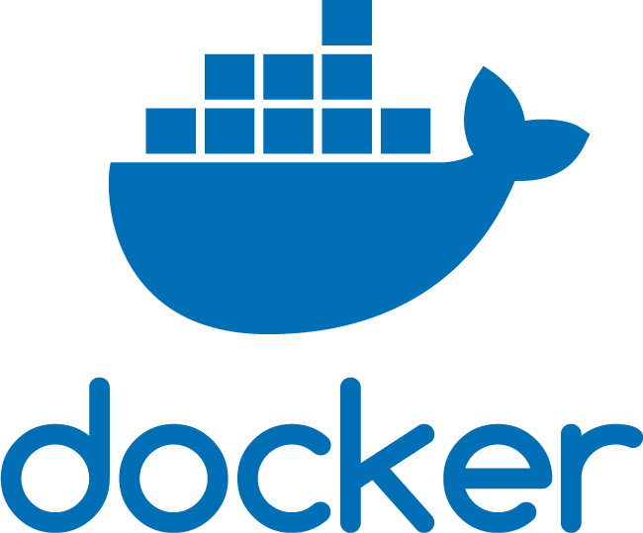
Docker in App Service on Linux
Testing/Staging On-Prem
Production in Azure
Development on Local Machine
App
App
Container Image
App
Notes:
Docker is all about the portability of containers. App Service on Linux uses Docker and its portability.
20532D
3: Hosting Web Applications on the Azure Platform

Slide 98
Lesson 2: Configuring an App Service App
AlwaysOn Domain Names Autoscaling Apps Demonstration: Autoscaling a Web App
Notes:
App Service provides many features that you can use to expand your web application’s capabilities. By using the Portal, you can enable different features of an App and modify the custom settings for the App
without redeploying the web application. This lesson lists the different configuration options that are available for an App.
Lesson Objectives
After completing this lesson, you will be able to:
• Describe the AlwaysOn feature.
• Describe how to use a custom domain with an App.
• Describe the auto-scale options for an App.
20532D
3: Hosting Web Applications on the Azure Platform

Slide 99
AlwaysOn
Only available for Basic/Standard tier
Ideal for continuous web jobs
Generates a simple HTTP request regularly
Intended as a heartbeat to make sure that the Web App does not recycle the app pool
Prevents Web Apps from being unloaded and forced to rebuild on next request
Notes:
You can describe the scenarios where AlwaysOn can be used, such as web jobs that operate over data continuously. You also can discuss the impact of keeping the application warm instead of loading and unloading the site.
AlwaysOn prevents your application from recycling due to going idle. AlwaysOn also improves your application startup time for early clients. This is accomplished by the Azure platform that regularly pings your App so that it is always active and is in a running state. This ensures that your application is already running before your first client requests are issued. It also ensures that your application remains in the running state and starts up in case of a recycle. AlwaysOn is available only for the Basic and Standard tier Apps.
20532D
3: Hosting Web Applications on the Azure Platform

Slide 100
Domain Names
Standard domain
[http/https]://<sitename>.azurewebsites.net
In Shared, Basic, or Standard mode, you can configure the Web App to use a custom domain
This involves managing the A and CNAME records with your registrar
Traffic Manager supports custom domain names
Notes:
Configuring Azure Web App Custom Domain Name:
Reference Link: http://go.microsoft.com/fwlink/?LinkID=510179
Domain Names
When you create a new App, a subdomain of the azurewebsites.net domain is assigned by using the following format:
[http|https]://<sitename>.azuresites.net
Azure also assigns a virtual Internet Protocol (IP) address for the same App instance. You can choose to use a custom domain name for your Web App and configure the custom domain name in the portal.
20532D
3: Hosting Web Applications on the Azure Platform

Slide 101
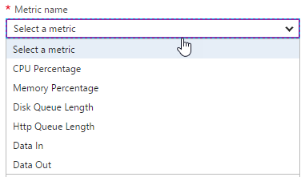
Design for Scalability and Performance
Scale Up – Change pricing tiers: Free, Shared, Basic, Standard, Premium
Scale Out – Change instance count: manually, auto
Scaling condition rules: Scheduled or Metric
Can have multiple condition rules
Can notify via email or webhook when autoscale events occur
Notes:
Design Web Apps for Scalability and Performance
Scale up an app in Azure
https://docs.microsoft.com/en-us/azure/app-service-web/web-sites-scale
Scale instance count manually or automatically
https://docs.microsoft.com/en-us/azure/monitoring-and-diagnostics/insights-how-to-scale?toc=%2fazure%2fapp-service-web%2ftoc.json

Slide 102
Autoscaling Apps
Scaling rules are specific to a schedule
Performance scaling can be configured using various metrics:
Memory
HTTP Queue
Disk Queue
Data In
Data Out
Metrics
CPU
Notes:
Deep-Dive into Web App Scaling:
Reference Link: http://go.microsoft.com/fwlink/?LinkID=510177
Do not spend a lot of time describing the methods on this slide. These specific methods can change as the portal is updated.
Mention that autoscaling is available only for Standard app service plans.
Autoscaling Apps
In many distributed application scenarios, you might want to scale out (horizontally) your application by increasing the number of instances of the application. Using the built-in load balancer, you can spread the load for your web application across multiple instances. This minimizes the per instance cost and ensures that your application meets the increasing demand from client devices or browsers.
With unpredictable application workloads, you can sometimes end up overestimating or underestimating the number of Apps that are needed to provide the best user experience.
20532D
3: Hosting Web Applications on the Azure Platform

Slide 103
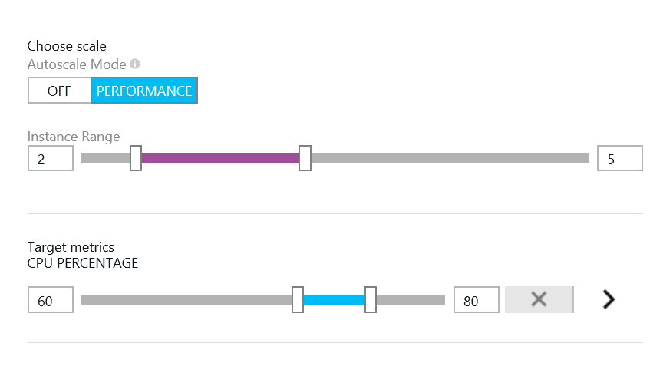
Performance Scaling
The Instance Range setting defines a minimum and maximum quantity of instances
You can use the CPU Percentage setting to set a CPU range
Minimum defines a threshold when instances should be removed
Maximum defines a threshold when instanced should be added
Notes:
Provide examples of situations where you might want to auto-scale your Web App by utilization. A good example will be a App with an unpredictable usage pattern that is bursts.
20532D
3: Hosting Web Applications on the Azure Platform

Slide 104
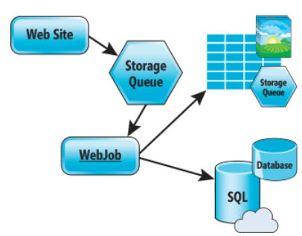
Design for Scalability and Performance
Design for Scale Out
Move towards stateless or at least distributed session/cache
Redis Cache for any Session/Cache needed
Move towards asynchronous UI
Queues for passing work off
Notes:
Azure Web Sites : Scaling Your Web Application with Azure Web Sites
https://msdn.microsoft.com/en-us/magazine/dn786914.aspx
Deploy Azure Web Apps to Multiple Regions for High Availability
Controlling Azure web app traffic with Azure Traffic Manager
https://docs.microsoft.com/en-us/azure/app-service-web/web-sites-traffic-manager
Add a Content Delivery Network (CDN) to an Azure App Service
https://docs.microsoft.com/en-us/azure/app-service-web/app-service-web-tutorial-content-delivery-network

Slide 105
Demonstration: Autoscaling a Web App
In this demonstration, you will learn how to:
Enable autoscale for a Web App
Notes:
Preparation Steps
Note: The demo steps are accurate as of the publishing date of this course. To view the latest demo steps, visit the GitHub repository for the course.
For this demonstration, you will use the available host machine. Before you begin this demonstration, you must complete the following step:
Verify that you received credentials to sign in to the Azure portal from your training provider. You will use these credentials and the Azure account throughout the labs in this course.
20532D
3: Hosting Web Applications on the Azure Platform

Slide 106
Lesson 4: Publishing an Azure App Service App
The Web Deploy Protocol Demonstration: Managing Application Settings
Notes:
After developing a web application, you can use Web Deploy to publish the application to Azure. By using the publish wizard in Visual Studio, you can customize the configuration settings and connection strings
before you publish the web application. This lesson will focus on the deployment options for App Service Apps in Azure.
Lesson Objectives
After completing this lesson, you will be able to:
• Describe how to publish a web application by using the publish wizard in Visual Studio.
• Describe how to transform the configuration settings of your web application.
• Describe the difference between the standard Release and Debug builds.
20532D
3: Hosting Web Applications on the Azure Platform

Slide 107
Comparing app deployment methods in App Service
Cloud
VSTS
Web app
GitHub
On-premises
TFS
Git
FTP, Web Deploy,
Visual Studio,
Web Matrix,
MSBuild
Notes:
Describe different deployment options for App Service apps.
Question
Given the flexibility that you have when choosing an app-hosting model in Azure, what key factors will influence your decision?
Answer
You can run your apps in Azure by using:
An app service.
A cloud service.
An Azure virtual machine (VM).
Your choice of hosting model depends on several factors, such as the level of control you want to maintain over the hosting environment and your ability to customize apps. You get full control of apps when they run in an Azure VM. App services are optimized for running web-based applications. As an example of a PaaS service, they eliminate the need to maintain virtual machines and web server software. By using App Service, you can quickly provision apps and integrate them with Visual Studio. This option is generally more economical than Azure VMs. However, in more complex scenarios, PaaS cloud services provide better scalability because they can scale web and worker roles independently.
20533D
5: Implementing Azure App Service

Slide 108
The Web Deploy Protocol
WebDeploy simplifies deployment of web applications and websites to IIS servers by providing a standard package format
Packages can be installed manually using IIS Manager, command line tools, or PowerShell
Packages can be remotely installed by using the IIS instance remote deployment service
Visual Studio and WebMatrix can deploy a web application to a Web Deploy endpoint
Notes:
Focus on how you can use Web Deploy to create a package for your Web App. You can use the Web Deploy package to specify not only the content and files for your web application, but also the configuration settings that should be changed on the target IIS instance. You also can specify the possible changes and migrations to external resources such as SQL Server. After you specify these changes and setting, an administrator can directly deploy the Web App on a machine with IIS or remotely deploy it by using the IIS Web Management Service (WMSvc).
Web Apps use Web Deploy as the preferred method for publishing a web application.
20532D
3: Hosting Web Applications on the Azure Platform

Slide 109
Deploying web apps
Advantages of Web Deploy:
Uploads only modified files
Supports HTTPS
Allows setting NTFS permissions
Supports database publishing
Allows setting connection strings
Scripted deployment with:
MSDeploy.exe
Azure PowerShell
Azure CLI
Git
FTP:
Passive vs active
Limitations in comparison with Web Deploy
Notes:
Compare Web Deploy and FTP. Describe different methods of automating deployments.
20533D
5: Implementing Azure App Service

Slide 110
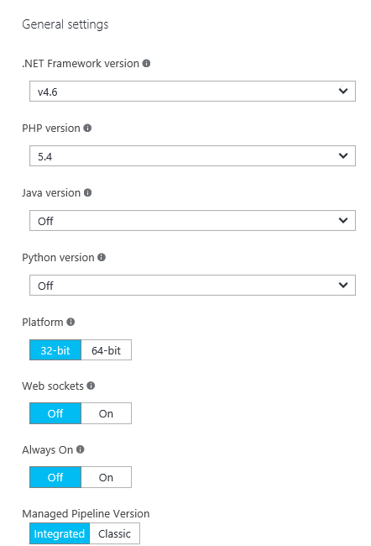
Configuring a web app’s application and authentication settings
Framework versions
Platform and Web sockets
Always On
Managed Pipeline Version
ARR Affinity
Auto Swap
Debugging
Certificates, Domain Names, and SSL Bindings
App Settings
Connection Strings
Default Documents
Diagnostic logs
Authentication and Authorization
Notes:
This slide includes many of the settings that appear in a web app’s Application settings blade.
Consider showing this blade to students as you talk about each setting. Also mention diagnostic logs as well as authentication and authorization settings.
Handler mappings
Use this area to add custom script processors to handle requests for specific file extensions
Virtual applications and directories
To configure virtual applications and directories, specify each virtual directory and its corresponding physical path relative to the website root. Optionally, you can select the Application checkbox to mark a virtual directory as an application.
https://docs.microsoft.com/en-us/azure/app-service/web-sites-configure
20533D
5: Implementing Azure App Service

Slide 111
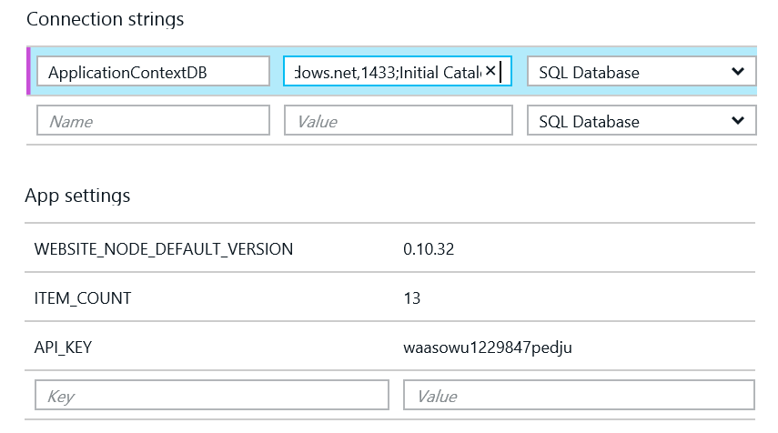
App Settings and Connection Strings
Application settings and connection strings can be managed in the portal
Connection strings are hidden by default
Notes:
Mention how these settings are injected by the host into an ASP.NET web application during startup. It is possible to access the appsettings and connectionStrings variables before these settings are injected.
These augment the values in your Web.config file appSettings and connectionStrings element[s].
20532D
3: Hosting Web Applications on the Azure Platform

Slide 112
Demonstration: Managing Application Settings
In this demonstration, you will learn how to:
Manage connection strings for a Web App
Manage app settings for a Web App
Notes:
Preparation Steps
Note: The demo steps are accurate as of the publishing date of this course. To view the latest demo steps, visit the GitHub repository for the course.
For this demonstration, you will use the available host machine. Before you begin this demonstration, you must complete the following step:
Verify that you received credentials to sign in to the Azure portal from your training provider. You will use these credentials and the Azure account throughout the labs in this course.
20532D
3: Hosting Web Applications on the Azure Platform

Slide 113
Deployment Slots
Deployment Slots are live apps with their own hostnames
Only available for Standard or Premium App Service plans
Number of slots available depend on App Service Plan
App content and configurations can be swapped between two deployment slots
Not all settings and configurations are swapped
Some settings can be marked to not swap
Testing in Production feature allows you to spread traffic across multiple deployment slots
Notes:
Update Azure Web Apps with Minimal Downtime
Set up staging environments in Azure App Service
https://docs.microsoft.com/en-us/azure/app-service-web/web-sites-staged-publishing

Slide 114
What gets Swapped with a Deployment Slot?
Swapped | Not Swapped
App Settings – can be configured to not swap | Custom Domain Names
Connection Strings – can be configured to not swap | SSL certificates and bindings
General settings | Scale settings (only production slots are scalable)
Handler mappings | Publishing endpoints
Diagnostic logs settings

Slide 115
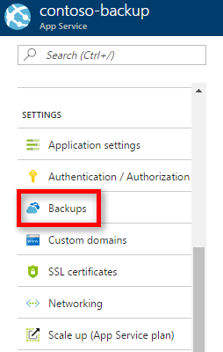
Backup Apps
App Service can back up the following information to an Azure storage account and container that you have configured your app to use:
App configuration
File content
Database connected to your app
https://docs.microsoft.com/en-us/azure/app-service/web-sites-backup

Slide 116
Configuring application and site diagnostics
Configure the following application logging settings:
Log storage location
Logging level
Retention period
Configure the following site diagnostics settings:
Web server logging
Detailed error messages
Failed request tracing
Notes:
Application and site logging are useful for generating data to help diagnose faults and poor performance. However, you should emphasize that web apps run faster when you are logging less diagnostic information. Therefore, when you investigate a specific problem, increase the application or site diagnostic levels, but when you are tuning for performance, log as little information as necessary.
20533D
5: Implementing Azure App Service

Slide 117
Monitoring web apps
Access diagnostic logs by using:
FTP
Azure PowerShell
Azure CLI
View logs in Visual Studio by using Application Insights
Monitor web apps in the Azure portal by:
Adding metrics
Configuring alerts:
Email notifications
Webhooks
Logic apps
Notes:
Describe different ways of managing and viewing diagnostic logs. Explain how to configure alerts.
20533D
5: Implementing Azure App Service

Slide 118
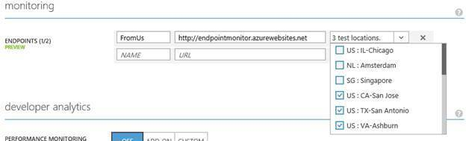
Configure App Service endpoint monitoring
Notes:
Web Server might have gone down
Database server might also have gone down.
Network issues
DNS issues
20533D
5: Implementing Azure App Service

Slide 119
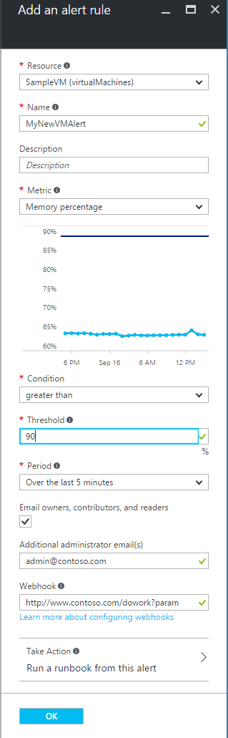
Configure Alerts
Triggers:
Metric values
Activity log events
Actions:
send email notifications
call a webhook
start execution of an Azure runbook
Notes:
You can receive an alert based on monitoring metrics for, or events on, your Azure services.
Metric values - The alert triggers when the value of a specified metric crosses a threshold you assign in either direction. That is, it triggers both when the condition is first met and then afterwards when that condition is no longer being met.
Activity log events - An alert can trigger on every event, or, only when certain events occurs. Learn more about activity log alerts.
You can configure a metric alert to do the following when it triggers:
send email notifications to the service administrator and co-administrators
send email to additional emails that you specify.
call a webhook
start execution of an Azure runbook (only from the Azure portal)
20533D
5: Implementing Azure App Service

Slide 120
Module 4
Storing SQL Data in Azure
Notes:
20532D
4: Storing SQL Data in Azure

Slide 121





Azure Data Services
Information Management
Data Store (small/big/all)
Machine Learning and Analytics
Intelligence
Cognitive Services
Data Sources
Machine Learning
Bot Framework
Data Factory
Data Lake
People
Data Lake Analytics
Cortana
Data Catalog
SQL Data
Warehouse
Business Scenarios
Web
Event Hub
Cosmos DB
HDInsight
(Hadoop and Spark)
Mobile
Apps
Recommendations,
customer churn,
forecasting, etc.
Apps
SQL Database
Stream Analytics
Bots
Dashboards & Visualizations
Sensors and devices
Power BI
Automated Systems
Data
Intelligence
Action
Notes:
To make this vision a reality, we Cortana Intelligence Suite – a suite of services in Intelligent cloud that transform data into intelligent insights and actions.

Slide 122
Module Overview
Azure SQL Database Overview Managing SQL Databases in Azure Azure SQL Database Tools Securing and Recovering an Azure SQL Database Instance Additional Managed Database Services
Notes:
Dynamic web applications must store the data that is being managed and manipulated by end users. ASP.NET technologies such as ADO.NET and Entity Framework provide a way for accessing data in SQL Server. In the cloud, the Microsoft Azure platform provides a database as a service offering that allows developers to use SQL in the same way as they would in an on-premises location. Lesson 1, “Azure SQL Database Overview,” describes the Azure SQL Database service and reasons you would consider using it. Lesson 2, “Managing SQL Databases in Azure,” describes the familiar and new management tools that are available for use with a SQL database that is hosted in Azure. Lesson 3, “Azure SQL Database Tools,” describes the SQL Server Data Tools (SSDT) templates, panes, and projects that are available in Microsoft Visual Studio 2013. Lesson 4, “Securing and Recovering an Azure SQL Database Instance,” describes the recovery scenarios relevant in Azure SQL Database. Lesson 5, “Azure Database for MySQL and PostgreSQL,” introduces the two managed database options for PostgreSQL and MySQL hosting.
Objectives
After completing this module, you will be able to:
• Describe the difference between Azure SQL Database editions.
• Explain some of the advantages and disadvantages of hosting databases in Azure SQL Database.
• Explain some of the advantages and disadvantages of hosting databases in a SQL Server installation on a virtual machine in Azure.
• Describe the tools that you can use to manage Azure SQL Database.
• Implement a high-availability solution with Azure SQL Database.
• Describe the Azure Database for MySQL and PostgreSQL services.
20532D
4: Storing SQL Data in Azure

Slide 123
Lesson 1: Azure SQL Database Overview
Azure SQL Database Azure SQL Database Tiers Databases as a Service vs. SQL Server in a Virtual Machine
Notes:
SQL Database provides a database-as-a-service offering that allows you to take advantage of many features that are familiar to developers and administrators who worked with SQL Server. SQL Database
exposes a tabular data stream (TDS) endpoint so that you can use many of your existing tools to connect to and manage your SQL Database instance.
This lesson describes the SQL Database service, some of the advantages of using this service, and some of the considerations for selecting between the SQL Database service and SQL Server on a virtual machine in
Azure.
Lesson Objectives
After completing this lesson, you will be able to:
• Describe the SQL Database service.
• Explain the advantages of using SQL Database.
• Explain the advantages of using SQL Server that is installed on a Virtual Machine in Azure.
• Compare the service tiers.
• Describe the SQL Database editions.
20532D
4: Storing SQL Data in Azure

Slide 124
Azure SQL Database
Fully managed database solution
Highly compatible with existing management tools
Built-in high availability and predictable performance as you scale out
Notes:
SQL Database is a relational database as a service offering that provides predictable performance and a high degree of compatibility with existing management tools.
Predictable Performance
By using a consistent unit of measurement, such as Database Throughput Units, you can compare the expected service level for each performance tier that is offered in the SQL Database service.
Consistent and predictable performance allows you to select a tier that very closely matches your application’s real-world utilization.
High Compatibility
A Tabular Data Stream (TDS) endpoint is provided for each logical server that is created in the SQL Database service. You can use existing SQL client applications and tools with SQL Database by using the TDS protocol.
Simple Management
Additional tools are available in Azure to manage databases that are created by SQL Database. A portal for managing database objects is available in the Azure Management Portal, which you can access by
clicking the Manage button. You also can manage SQL Database instances by using the portals, REST API, Windows PowerShell, or the cross-platform command-line interface (Xplat CLI).
20532D
4: Storing SQL Data in Azure

Slide 125


Azure SQL Database
PaaS Offering. Database-as-a-Service
Relational database.
Service tiers:
Basic
Standard
Premium
Premium RS
Elastic Pools. Pooled databases delivers performance
Source: Microsoft

Slide 126
Azure SQL Database Tiers
Tiers
Basic
Standard
Premium
Retired tiers
Web
Business
Notes:
Start a discussion with the students on when they would need reserved resources. Some examples are applications that need predictable latency, handle many concurrent requests, or have a high-peak compute load.
Remind the students that this doesn’t mean that Standard databases are slow. They are consistent in their performance and the Premium offerings are there for scenarios when more is needed.
• Basic: Ideal for simple databases that requires only a single connection performing a single operation at a time.
• Standard: The most common option and is used for databases that require multiple concurrent connections and operations.
• Premium: Designed for applications that require large quantities of transactions at volume. These databases support a large quantity of concurrent connections and parallel operations.
20532D
4: Storing SQL Data in Azure

Slide 127
Service Tiers
Basic
Small size
Low traffic
Single active operation
Standard
Low to medium IO performance requirements
Multiple current queries
Premium
High transaction volume
High IO performance requirements
Many concurrent users
High availability
For mission critical apps
Premium RS
IO-intensive apps
Does not require high availability
Analytical workloads

Slide 128
Service Tier Attributes
Service tier features | Basic | Standard | Premium | Premium RS
Maximum single database size | 2 GB | 250 GB | 4 TB* | 1 TB
Maximum elastic pool size | 156 GB | 4 TB | 4 TB* | 1 TB
Maximum database size in an elastic pool | 2 GB | 250 GB | 500 GB | 500 GB
Maximum number of databases per pool | 500 | 500 | 100 | 100
Maximum single database DTUs | 5 | 100 | 4000 | 1000
Maximum DTUs per database in an elastic pool | 5 | 3000 | 4000 | 1000
Database backup retention period | 7 days | 35 days | 35 days | 35 days
SKUs | Basic | S0-S12 | P1-P6, P11, P15 | PRS1, PRS2, PRS4, PRS6
https://docs.microsoft.com/en-us/azure/sql-database/sql-database-service-tiers

Slide 129
Databases as a Service vs. SQL Server in a Virtual Machine
SQL Database
SQL Server in an Azure VM
Standardized, interoperable, and scalable managed database solution
Contains size limits for each standard edition
Requires some re-architecture of existing applications
Ideal for new cloud-based applications
Provides high compatibility with SQL on premise
Ideal for existing applications that require the SQL installation to be customized
Requires more maintenance and customization to achieve scalability
Notes:
Selecting between SQL Database and SQL Server on virtual machines in Azure can be debated infinitely. SQL/VM is ideal for scenarios where you need to migrate an existing application or you are having a tightly planned database scale (scale up). SQL Database is ideal for new applications and applications that need to scale on demand.
Hosting Data in SQL Database
• This solution is ideal for new applications that are based on cloud technologies, where requirements dictate that you do not need to customize the behavior of SQL Server. Many applications use SQL Server for storage, programmatic functionality, and basic query operations.
Hosting Data in SQL Server Standalone in a Virtual Machine in Azure
• This solution is highly compatible with existing SQL applications that are hosted in an on-premises location. You can migrate the installation of SQL Server from an on-premises location to Azure by uploading the virtual hard disks. Because of this, you can use this solution in scenarios where you want to migrate your existing database workload without modifying it.
• Existing applications with a customized SQL installation benefit from using SQL Server Standalone on a virtual machine in Azure. For example, SQL Server Analysis Services (SSAS) is not available for the SQL Database service. If you host SQL Standalone on a virtual machine in Azure, you can enable the services that are used with SSAS.
20532D
4: Storing SQL Data in Azure

Slide 130
Databases as a Service vs. SQL Server in a Virtual Machine
Azure SQL Databases
SQL Server in an Azure VM
Can be made available to any Azure service by selecting an option in the portal
Can be made available to specific IP addresses through the portal
A port must be opened so you can connect to the SQL instance from outside of the VM
Azure Services are treated like any other outside connection
Notes:
20532D
4: Storing SQL Data in Azure

Slide 131
Lesson 2: Managing SQL Databases in Azure
Creating an Azure SQL Database Instance Demonstration: Creating a SQL Database
Notes:
This lesson focuses on the tools that are available in the Azure portal to create and manage databases.
The Management Portal provides convenient ways to create and manage databases. There is also a unique portal that you can use to manage the tables, views, and other objects for your SQL database.
This lesson lists the various online management tools that are available for interacting with SQL databases in Azure.
Lesson Objectives
After completing this lesson, you will be able to:
• Create a server and a database by using the Management Portal.
20532D
4: Storing SQL Data in Azure

Slide 132
Creating an Azure SQL Database Instance
The SQL Database service
The server instance
The database instance
Notes:
Creating a server is the first step in creating SQL databases in Azure. Even if you try to create a database without a server, you will be prompted with dialog boxes to create a server along with the database. You can use the server to logically group your databases and also to use existing tools that understand the server to database taxonomy.
You can create a new database instance in the SQL Database service by using the portals, Service Management REST API, Windows PowerShell, or Visual Studio 2013. Later in this lesson, screenshots are provided to show you how to create a database in the Management Portal and a demonstration is included to show you how to create a database in the Azure Preview Portal. Before creating a database instance, you must create a logical server.
20532D
4: Storing SQL Data in Azure

Slide 133
Demonstration: Creating a SQL Database
In this demonstration, you will learn how to:
Create a SQL Database instance by using the Portal
Create a logical server instance by using the Portal
Notes:
Preparation Steps
Note: The demo steps are accurate as of the publishing date of this course. To view the latest demo steps, visit the GitHub repository for the course.
Before starting this demo, you must complete the lab in Module 2. For this demo in this module, you will use the available host machine. Also, you must complete the following steps:
On the host computer, click Start, type Remote, and then click Remote Desktop Connection.
In Remote Desktop Connection, provide the name of your virtual machine in the Computer box by using the following format:
vm20532[Your Name Here].cloudapp.net:[Your VM RDP Port]
Note: The name and port for your virtual machine might be saved in the Computer drop-down list. If this is the case, use this value instead of typing it in manually. If you are unsure about your virtual machine’s RDP port, use either of the Azure portals to find your virtual machine’s endpoints. The endpoint with the name Remote Desktop is the correct port for RDP. This port is randomized to protect your virtual machine from unauthorized access.
In Remote Desktop Connection, click Connect. Wait until the RDP client accesses the virtual machine.
If necessary, sign in by using the following credentials:
User name: Student
Password: AzurePa$$w0rd
Verify that you received the credentials to sign in to the Azure portal from your training provider. You will use these credentials and the Azure account throughout the labs in this course.
20532D
4: Storing SQL Data in Azure

Slide 134
Lesson 3: Azure SQL Database Tools
SQL Server Management Studio Migration Tools
Notes:
This lesson covers developer-centric tools that are available in Visual Studio 2013. You can use these tools to manage both SQL databases in Azure and SQL Server databases on a virtual machine in Azure.
One of the advantages of SQL databases in Azure is the ability to use many monitoring tools that you use for on-premises databases. This lesson describes the existing management tools and how you can use them to manage SQL databases in Azure.
Lesson Objectives
After completing this lesson, you will be able to:
• Manage your SQL Database instances by using SQL Server Management Studio.
• Manage your SQL Databases instances using Visual Studio’s tools.
20532D
4: Storing SQL Data in Azure

Slide 135
SQL Server Management Studio
You can connect to an Azure SQL Database using many of the tools that you use right now such as SQL Server Management Studio:
First, you must add your IP address to the firewall rules of allowed IP addresses. This is done in the configuration page for the server
The Server Name is viewable on the dashboard of the database or the server
Use SQL Server Authentication and the username/password you set up in the creation of the server
Notes:
Mention to the students that you can use familiar tools to manage your SQL Server instances. Although there are some limitations, the overall experience will be very familiar. The following slides cover the tools that are available in Visual Studio 2013 to manage a SQL database whether it is on a virtual machine or it is managed.
One of the greatest benefits of using the TDS protocol is that it provides many tools for connecting to SQL databases and servers. Because the protocol is fully supported by the SQL Database service, the client tools and applications do not need to be concerned about the actual architectural implementation. This enables scenarios where you can use a local SQL installation (such as LocalDb) for development and testing a SQL database for production. You can make this transition by swapping connection strings as appropriate.
20532D
4: Storing SQL Data in Azure

Slide 136

Visual Studio Server Explorer
You can use Server Explorer to manage SQL databases in the same way as you use SQL Server Management Studio
The improved query editor and updated preview tools can be helpful for determining the collateral of changes made through a SQL script
Notes:
Even though students might have used Server Explorer in the past, encourage them to check out the Server Explorer again. The script editor and table designer are enhanced greatly with Visual Studio 2013. This is a great way to allow a development team to view the SQL database in Azure and their on-metal development database side by side.
20532D
4: Storing SQL Data in Azure

Slide 137

Visual Studio SQL Server Object Explorer
You can use the SQL Server Object Explorer to manage your local databases or SQL databases in Azure
You can access the SQL Server Object Explorer by right-clicking a database in Server Explorer
Notes:
20532D
4: Storing SQL Data in Azure

Slide 138

Visual Studio Database Projects
Database projects in Visual Studio allow you to:
Place the schema of a database in-development within source control
Publish the database to a SQL Database instance
Notes:
Discussion Question: Why would you use a database project to create your schema as opposed to a SQL management tool?
You can use a database project to place the design in source control, share the design among your team members, and roll back to previous revisions of the design. You also can use it to generate SQL scripts from the design that can be used to create development copies of the database locally.
20532D
4: Storing SQL Data in Azure

Slide 139
Migration Tools
You can use SQL Server Integration Services to define a migration plan for on-premises databases
SQL Database Migration Wizard analyzes your existing database and generates a script (and bulk copy files) to migrate your database
Azure Websites Migration Assistant uses SQL Management Objects to analyze your existing database and migrate it
Notes:
SQL Migration Scripts
You can generate migration scripts by using the Generate Scripts task in SQL Server Management Studio.
Importing and Exporting Data-Tier Applications
You can export the data-tier applications from a SQL database and import them into another.
• A data-tier application contains the definitions of the objects in the database.
• The application package also contains the data that is stored in the different database objects.
• You can import data-tier applications into a SQL database in Azure.
SQL Server Integration Services (SSIS)
You can use SSIS to both plan and perform migration of data from a SQL Server standalone installation to a SQL database in Azure. This is ideal for scenarios where the existing database uses the functionality that
is not supported in the SQL Database service.
Microsoft Azure SQL Database Migration Wizard
This migration wizard, also known as SQLAzureMW, is designed to analyze existing databases and eventually perform a migration to SQL Database. The tools support a large range of SQL versions starting
from SQL Server 2005.
20532D
4: Storing SQL Data in Azure

Slide 140
Elastic Database Pools
Collection of Elastic Database Transaction Units (eDTUs) and storage resources
Deploy several databases in the same Elastic pool
Resources are shared between all of the databases within the pool
Cost-effective solution to manage multiple databases and implement sharing patterns
Notes:
20532D
4: Storing SQL Data in Azure

Slide 141


When to Use Elastic Pools
Databases with specific utilization patterns:
Low average utilization
Infrequent usage spikes
Large differences between peak usage per database
Peak usage of databases occurs in different point in time
Notes:
20532D
4: Storing SQL Data in Azure

Slide 142
Lesson 4: Securing and Recovering an Azure SQL Database Instance
Recovery Options for Azure SQL Database Azure SQL Databases Geo-Replication
Notes:
Both SQL Server standalone and SQL Database offer a comprehensive set of replication and disaster recovery options.
This lesson describes the high availability features for both SQL Server standalone and SQL as a Service in Azure.
Lesson Objectives
After completing this lesson, you will be able to:
• Describe the geo-replication options for SQL databases in Azure.
• Describe the high availability functionality for SQL Server.
20532D
4: Storing SQL Data in Azure

Slide 143
Recovery Options for Azure SQL Database
You can count on infrastructure redundancy in the Azure data centers for the most basic scenarios
SQL Database also provides its own set of options for HADR:
Built-in replicas:
Transactions are not considered committed to the database until they are written to the target DB, one primary replica, and two secondary replicas
Backup and restore:
Allows you to protect against errant transactions
Database is backed up as a whole and can be recovered through the portal
The retention period (in days) of your backup is based on your selected service tier
Notes:
Business continuity describes the planning and execution of maintaining running business operation when an unforeseen event occurs. Azure SQL Database offers many business continuity features with your databases that you would normally have to plan, design and implement. The Azure SQL Database infrastructure also uses replication to implement basic failover for your application within its own infrastructure.
20532D
4: Storing SQL Data in Azure

Slide 144
High Availability for Azure SQL Databases
Database copy:
You can create a one-time copy of the database within the same region
The copy is disconnected from the source database so any future transactions will not be applied to the copy
The import and export service:
You can import and export BACPACK files from a database instance either automatically or manually
You can use this service to offer a minimum HADR option for web and business databases that do not support the point-in-time recovery option
You also can use this service for custom backup and recovery scenarios
Notes:
Point-in-Time Restore
Point-in-time restore returns your database and its data to an earlier point in time. The tier of your database determines how far back you can restore your database.
Database Copy
The database copy feature creates a one-time copy of your database to a new instance in another datacenter. When the operation is complete, the duplicate database is transactionally consistent with the
source database. Further transactions against the source database are not copied.
The Import and Export Service
This service allows you to create a copy of your database in the .BACPAC format. This file contains a copy of both the data and schema of a database. This file can then be used to import a database into any other
Azure SQL Database instance or a SQL Server installed standalone on a machine.
Geo-Restore
Geo-restore behaves in a similar manner to point-in-time restore. The primary difference is that georestore replicates the database to a datacenter in another region. Geo-restore is typically used when there is an outage in a specific Azure region.
20532D
4: Storing SQL Data in Azure

Slide 145
Azure SQL Databases Geo-Replication
Active geo-replication is available for Premium SQL Database instances
This feature is asynchronous by default and guarantees that replicas will be eventually consistent
You can replicate transactions to as many as four copies of the database
Replicas can exist in different regions for geo-redundancy
You can use the replica of the database as a read-only data source in load-balancing scenarios
Example: An application uses the primary database for line-of-business functionality and the replica for reports
Notes:
Active Geo-replication
Out-of-the-box, active geo-replication offers the same functionality as standard geo-replication for a simple failover scenario. Active geo-replication goes even further and can maintain up to four copies of
your database that are replicated in a synchronous (continuous) manner. The secondary databases are readable so that your data is still available in an uninterrupted manner while you conduct your failover
orchestration.
20532D
4: Storing SQL Data in Azure

Slide 146

SQL Database Security
Firewall & Firewall Rules
Service Endpoints
Auditing for compliance and security
Encryption
TDE( Now supports BYOK, in public Preview)
Always Encrypt
Authentication: “Who are you?”
SQL Authentication
Azure Active Directory (AAD) Authentication (supports Federated identities and MFA)
Authorization
“What can you do?”
Dynamic data masking: Hide sensitive data from non-privileged users
Row-level security

Slide 147
Azure SQL Keywords
TDE
SQL Firewall
DTU(Database Transaction Unit)
eDTU(Elastic DTU)
Always Encrypt
Azure AD integrated Authentication
Dynamic data masking
Long term backup retention
Row Level Security
Failover Groups
Audit and threat detection
Active directory admin
Elastic pool
Geo Replication
Vulnerability Assessment
Data Sync

Slide 148
Lesson 5: Additional Managed Database Services
Azure Database for MySQL Azure Database for PostgreSQL
Notes:
This lesson introduces the Azure Database services for MySQL and PostgreSQL and then compares the database services to the previously introduced Azure SQL Database service.
Lesson Objectives
After completing this lesson, you will be able to:
• Describe the Azure Database for MySQL Service.
• Describe the Azure Database for PostgreSQL Service.
• Migrate content from a PostgreSQL database to an Azure Database for PostgreSQL managed instance.
• Integrate Azure Database for MySQL with an Azure Web App.
20532D
4: Storing SQL Data in Azure

Slide 149
Managed Database Platform
Unified platform for all managed database services
Power BI, App Services, Data Factory, Analytics, ML, Cognitive, Bot…
SQL Data Warehouse
SQL Database
MySQL
PostgreSQL
Azure Database
Services Platform
Transparency: Advisors, Tuning, Monitoring
Flexibility: On-demand scaling, Resource governance
Security: HA/DR, Backup/Restore, Security, Audit, Isolation
Azure Compute
Azure Storage
Azure Platform
Notes:
MySQL and PostgreSQL shares the same “underpinnings” as SQL Database.
20532D
4: Storing SQL Data in Azure

Slide 150
Conceptual Model
Account
*
Subscription
Logical with provisioned compute and storage resources
Connection endpoint for PostgreSQL/MySQL server
Can create one to many user databases
Pinned to a region
Policy scope, e.g., firewall rules, recovery, monitoring, and management
*
Resource Group
*
*
Database
Notes:
20532D
4: Storing SQL Data in Azure

Slide 151
Integrated Security
Identity
Native authentication
Access Control
Secure SSL connectivity
Server firewall rules
Protect data
Built-in encryption for application data and backups
Notes:
20532D
4: Storing SQL Data in Azure

Slide 152
Azure Database for MySQL
Based on MySQL Community Edition
Shares common features with other managed database services:
Provision in minutes with built-in high availability
Predictable performance
Scale on the fly without application downtime
Secured to protect sensitive data at-rest and in-motion
Automatic backups and Point-In-Time-Restore for up to 35 days
Deep integration with Azure Web Apps
Notes:
Azure Database for MySQL is a relational database service based on the open source MySQL Server engine.
20532D
4: Storing SQL Data in Azure

Slide 153




Connecting to MySQL Instance
Azure CLI
Azure Portal
Custom Mgt. App
REST API
Common solution for access control, identity, deployment notifications, metrics, billing…
Azure Resource Manager
Server provisioning and management
Azure Database Services Platform
US West
Database Tools
Application
MySQL Client
MySQL Server
MySQL Client
Notes:
20532D
4: Storing SQL Data in Azure

Slide 154
Integration with Azure Web Apps
Tightly integrated with Azure Web Apps as a DB Provider
Deploy a new Web App + MySQL and add your own app
Preconfigured Web Apps:
PHP
Wordpress
Drupal
Ghost
Deploy through CLI using your own customized ARM deployment template
Notes:
20532D
4: Storing SQL Data in Azure

Slide 155
Azure Database for PostgreSQL
Based on PostgreSQL Community Edition
Shares common features with other managed database services:
Provision in minutes with built-in high availability
Predictable performance
Scale on the fly without application downtime
Secured to protect sensitive data at-rest and in-motion out-of-the-box
Automatic backups and storage for recovery to any point up to 35 days
Use native tools, drivers and libraries
Notes:
Azure Database for PostgreSQL is a relational database service based on the open source Postgres database engine.
Azure Database for PostgreSQL is a relational database service in the Microsoft cloud built for developers based on the community version of open source PostgreSQL database engine. Azure Database for PostgreSQL offers the same features as Azure Database for MySQL:
• Built-in high availability with no additional cost.
• Predictable performance, using inclusive pay-as-you-go pricing.
• Scale on the fly within seconds.
• Secured to protect sensitive data at-rest and in-motion.
• Automatic backups and point-in-time-restore for up to 35 days.
• Enterprise-grade security and compliance.
20532D
4: Storing SQL Data in Azure

Slide 156

Connecting to PostgreSQL Instance
Azure CLI
Azure Portal
Custom Mgt. Applications
REST API
Common solution for access control, identity, deployment notifications, metrics, billing…
Azure Resource Manager
US West
Server provisioning and management
Azure Database Mgmt Service
Database Tools (Pgadmin, psql)
Application
mypgserver
Postgres Client
Postgres v3
Postgres v3
Postgres Client
Notes:
20532D
4: Storing SQL Data in Azure

Slide 157
Migrating to Managed PostgreSQL
Profiles Data Warehouse
Create service using portal
Export an existing database using pg_dump
Create database and users on PostgreSQL service
Import using psql
Postgres on Linux
2.5G Dump File (for one database)
File System
Profiles Data Warehouse
Postgres Managed Service
Notes:
20532D
4: Storing SQL Data in Azure

Slide 158
Lab: Storing Event Data in Azure SQL Databases
Exercise 1: Creating an Azure SQL Databases Instance Exercise 2: Using Entity Framework with Local SQL Server Exercise 3: Using Entity Framework with Azure SQL Databases
Notes:
Occasionally the Preview Portal may not successfully create a new service instance. The portal is still technically in preview and can potentially have unresolved bugs. If this happens, you can simply retry the operation until your service instance is successfully created.
Exercise 1: Creating an Azure SQL Databases Instance
Exercise 2: Using Entity Framework with Local SQL Server
Exercise 3: Using Entity Framework with Azure SQL Databases
20532D
4: Storing SQL Data in Azure

Slide 159
Module 5
Storing Unstructured Data in Azure
Notes:
20532D
6: Storing Unstructured Data in Azure

Slide 160
Module Overview
Azure Storage Overview Azure Storage Tables Azure Cosmos DB
Notes:
Many new application workloads require new databases that offer scale and flexibility far beyond the capabilities of a traditional relational database. In Azure, there is a wide variety of NoSQL database services available for applications to store unstructured data in a flexible, schema-free and scalable fashion. Lesson 1, “Azure Storage Overview,” introduces the Azure Storage service and details some of the storage types available to applications using Azure Storage. Lesson 2, “Azure Storage Tables,” details the Table key-value store available as a NoSQL database in Azure Storage. Lesson 3, “Azure Redis Cache,” introduces the Redis Cache key-value based NoSQL store and details how it can be used as a cache database. Lesson 4, “Azure Search,” describes the Azure Search service offering that indexes and provides rich-search capabilities for documents stored in structured and unstructured storage. Lesson 5, “Azure Cosmos DB,” explores the Azure Cosmos DB service as a flexible NoSQL database that supports a large variety of APIs and models.
Objectives
After completing this module, you will be able to:
• Describe the Azure Storage service.
• Use Azure Search or Cosmos to store NoSQL data.
• Use Azure Redis Cache to store cache data.
20532D
6: Storing Unstructured Data in Azure

Slide 161
Lesson 1: Azure Storage Overview
Azure Storage Types of Storage Geo-Replication in Azure Storage Accessing Storage Data
Notes:
Microsoft Azure Storage enables you to store unstructured data, files, and messages. You can use Storage as a shared resource to your cloud applications and the various instances of each service.
This lesson provides a brief overview of Storage.
Lesson Objectives
After completing this lesson, you will be able to:
• Describe the Storage service.
• Identify the types of storage available.
• Describe geo-replication of Storage data.
20532D
6: Storing Unstructured Data in Azure

Slide 162
http://azureplatform.azurewebsites.net/
* Preview Services
Notes:
Many new application workloads require new databases that offer scale and flexibility far beyond the capabilities of a traditional relational database. In Azure, there is a wide variety of NoSQL database services available for applications to store unstructured data in a flexible, schema-free and scalable fashion. Lesson 1, “Azure Storage Overview,” introduces the Azure Storage service and details some of the storage types available to applications using Azure Storage. Lesson 2, “Azure Storage Tables,” details the Table key-value store available as a NoSQL database in Azure Storage. Lesson 3, “Azure Redis Cache,” introduces the Redis Cache key-value based NoSQL store and details how it can be used as a cache database. Lesson 4, “Azure Search,” describes the Azure Search service offering that indexes and provides rich-search capabilities for documents stored in structured and unstructured storage. Lesson 5, “Azure Cosmos DB,” explores the Azure Cosmos DB service as a flexible NoSQL database that supports a large variety of APIs and models.
Objectives
After completing this module, you will be able to:
• Describe the Azure Storage service.
• Use Azure Search or Cosmos to store NoSQL data.
• Use Azure Redis Cache to store cache data.
20532D
6: Storing Unstructured Data in Azure

Slide 163
Azure Storage
The Azure Storage services allow you to store records, files, and simple requests in a flexible, managed, and scalable solution
Separating the storage of your data from your application allows more flexibility when planning and scaling different aspects of your cloud application scenario(s)
Storage services are massively scalable which allows you to store large sets of data without being forced to plan partitioning and sharding of your data
Notes:
The key point to remember in Azure Storage is how hands-off it is. A software development kit (SDK) is most popular programming languages along with a REST API gives you a simple and consistent way to access your data. Because Storage services support massive scale, you are not forced to plan for partitions or federation like you do with SQL Database.
Ensure that you emphasize the fact that Storage supports massive scale. There are few limits on storage (outside of transactions per second) and it’s built for massive data storage.
With cloud computing, flexible infrastructure is now available for applications that were designed with infrastructure, resilience and scalability in mind. Cloud Services automatically handle the load balancing and infrastructure creation (spin-up) when you wish to scale your application up or down. DocumentDB partitions your data across multiple nodes automatically to grow to handle the amount of data you wish to store.
Storage is the foundational service that supports all of these flexible services. Storage was designed to make it possible for developers to build large-scale applications by providing a storage
mechanism that automatically scales to handle the application’s workload. Storage is massively scalable and it is possible to storage large sets of data for data mining, analytical and media workloads.
20532D
6: Storing Unstructured Data in Azure

Slide 164



Storage Accounts
Blob Storage
Table Storage
Queue Storage
File Storage
Notes:
Quickly introduce each of the three storage types. The next slide provides some information about these that you can expand on.
20532D
6: Storing Unstructured Data in Azure

Slide 165
Types of Storage
Tables
Blobs
Queues
Notes:
Quickly introduce each of the three storage types. The next slide provides some information about these that you can expand on.
20532D
6: Storing Unstructured Data in Azure

Slide 166
Types of Storage
Tables
Store related records
Blobs
Store files, drives, and multimedia
SAS tokens are available to protect stored content
Queues
Store and manage simple messages or requests
Unstructured table storage
Very efficient key lookups
Notes:
Blob
Storage blobs provide a way to store files so that they can be consumed by other components of your application or client devices. These blobs represent files and can be protected such that tokens are required to access the blob.
Table
The Table service is a NoSQL store that is based on the document paradigm. Each entity consists of a partition key and a row key that together form a unique index. The entities then contain a collection of key-value pairs for the document’s attributes.
File
File is a service that publishes a Server Message Block (SMB) 2.1 endpoint. This endpoint can be used by virtual machines in Azure in the same way as a shared drive.
Queue
Storage queues are externally managed queues that can persist requests to be consumed by modules in your application. The queue is implemented in a traditional first in, first out (FIFO) pattern. These queues can be measured and requests can also be reviewed (peek) without removing them from the queue.
20532D
6: Storing Unstructured Data in Azure

Slide 167
Geo-Replication in Azure Storage
Locally Redundant Storage (LRS)
Default option
Data is replicated to three different nodes within the same datacenter
Zone Redundant Storage (ZRS)
Data is replicated to three different datacenters within the same region
It is possible for data to be replicated across region boundaries if there are not enough datacenters for storage within the region
Notes:
Locally Redundant Storage (LRS)
This is the simplest and least expensive option. As you know, three copies of your data exist within the same datacenter. If you have data that does not require any replication, then you can use this option and achieve significant cost savings. However, the flip side is that although the data might survive a single physical fault, an outage to the entire datacenter will make this data typically unavailable.
Zone-Redundant Storage (ZRS)
This option replicates your data to another datacenter within the same region. This ensures that your data is available even if there is a fault or outage to an entire datacenter. There are still only three copies, but they are spread out across multiple datacenters in the region.
20532D
6: Storing Unstructured Data in Azure

Slide 168
Geo-Replication in Azure Storage
Geo-Redundant Storage (GRS)
Data is replicated to three different nodes within the primary datacenter
Data is replicated asynchronously to three nodes within a fixed redundant datacenter
Data is “eventually consistent”
Read Access – Geo-Redundant Storage (RA-GRS)
Similar to GRS, data is replicated to a redundant datacenter
Access to the secondary data source is read-only
Notes:
The geo-redundant storage options are eventually consistent. This means that the replication is done asynchronously to the secondary data center and it is possible to access the secondary storage before the replication is complete. The client application can also access the last sync time and the amount of time the application should wait before expecting consistency between the two storage endpoints.
Geo-Redundant Storage (GRS)
GRS replicates your data to a secondary datacenter in a different region. There will still be three copies in your primary datacenter, but with this option there will be three new copies in the new datacenter.
Copies are committed in an asynchronous manner. The primary datacenter will commit the new data and then return a HTTP status message before the secondary datacenter performs a commit. This data pattern is typically referred to as eventually consistent.
Read-Access Geo-Redundant Storage (RA-GRS)
RA-GRS behaves the same way as GRS. The primary difference is that your applications can now access the secondary data in a read-only manner. This is useful for read access during an outage or for distributing your workload across datacenters. For example, your web application can read and write data to the primary datacenter and your reporting application can simply read data from the secondary datacenter
20532D
6: Storing Unstructured Data in Azure

Slide 169
Accessing Storage Data
Access to resources are authenticated by using a shared key for your storage account
You can configure blobs to allow anonymous access
You can generate shared access signatures to give a client controlled, temporary access to a storage resource
Storage accounts are given two keys that can be regenerated at any time
Allows you to rotate keys and regenerate keys on a scheduled basis without your application losing access to the resources
Notes:
You might want to talk about rotating keys. For example, the application might be currently using the primary key. However, when it’s time for a new key, the application can switch to the secondary key and regenerate the primary key. Explain how this can help in minimizing the downtime for the application.
Discussion Question: Why would your application regenerate keys on a scheduled basis?
Shared Access Signature
A Shared Access Signature is a set of query parameters that can be used by a client to access the resource. The query parameters specify the access level and expiration time, but this data is verified by a signature so it can’t be modified manually. Libraries are available to generate the signature in an ad-hoc manner.
Stored Access Policy
Sometimes, signatures need to be generated in a planned manner as opposed to ad-hoc. You can define a Stored Access Policy to create a uniform description that can be used to generate multiple shared access signatures. The policy goes even further and provides a centralized control mechanism for the previously generated signatures.
20532D
6: Storing Unstructured Data in Azure

Slide 170
General Purpose Storage Account
Universal usage
Can contain storage services of any type
Standard
Queues
Tables
Blobs
Files
Premium
Used to store VM disks
Notes:
20532D
6: Storing Unstructured Data in Azure

Slide 171
Lesson 2: Azure Storage Tables
Storage Tables NoSQL Data in Storage Tables Demonstration: Implementing Azure Storage Tables Common Transactions OData Queries
Notes:
The Table service provides a nonrelational database option for storage in Azure. It is tuned to scale to large number of entities and even numerous operations per second. Simply put, the Table service is built with scalability in mind.
This lesson introduces the Table service and describes why it is unique.
Lesson Objectives
After completing this lesson, you will be able to:
• Describe the Table service.
• Explain the structure of data and partitions in Table storage.
• Describe the relationship between OData and Table storage.
20532D
6: Storing Unstructured Data in Azure

Slide 172
Storage Tables
Table storage allows you to store flexible datasets that are not constrained by a schema or a model
Client applications can dictate the model of the data stored
Complex objects of different schema(s) can be stored in the same table
Built for massive scale (very large datasets)
Data is partitioned by using a partition key to support load balancing across different nodes
Data is indexed by a combination of the partition key and a row key for very fast lookup
Notes:
Explain how Table storage can be used for much larger datasets that would typically require sharding a relational database system.
Talk about the partition key and row keys as the efficient index in a table. Table scans are very expensive in this format.
The Table service provides a NoSQL data storage mechanism to store loosely structured data in a table that you can partition by using a unique partition key. The ideal candidate for Table
storage is rarely-modified or immutable data that needs to be stored at a very large scale and accessed very quickly. With traditional relational database management systems, massive data
storage is possible but queries are expensive. If you want to access a single item in a table, then you will need a query and this might end up being exponentially more expensive as the size of
the table grows.
20532D
6: Storing Unstructured Data in Azure

Slide 173
NoSQL Data in Storage Tables
Table storage is a NoSQL database
Implemented as a key-value store
Tables contain entities that are partitioned across multiple nodes by using the partition key
Entities have an index, which is a combination of the partition and row keys
Properties of a particular entity are implemented as a collection of key-value pairs
Key is the name of the property
Value is the value for the property
Notes:
NoSQL Data in Storage Tables The Table service data model can be daunting at first. Tables are composed of partitions. These partitions contain data that is related by the PartitionKey. Each individual entity in a partition has a unique row key. In the table, the partition key and row key must be unique for every entity and they behave in a manner similar to a compound index. Data in the same partition is served from the same physical server, which explains why a query that scans only a single partition is still very efficient.
20532D
6: Storing Unstructured Data in Azure

Slide 174
NoSQL Data in Storage Tables
PartitionKey: Student RowKey: 145A
FirstName
Chad
PartitionKey: Student RowKey: 287C
FirstName
LastName
PartitionKey: Teacher RowKey: 945FT
LastName
Grade
LastName
Drayton
Age
8
Joann
Chambers
Grade
3
Summers
5
Grade
3
Notes:
Here is an example of a People table for a school. The table is partitioned by Students or Teachers. If the number of students is large or if you expect the school to grow, then you can partition the table by Grade-level or some other value. The row keys are the unique identifiers within a partition. The unique identifier for the entities is the combination of the partition key and the row key. This diagram demonstrates how entities of various schema can be stored in the same table. Each entity is a collection of key-value pairs representing its properties.
This slide should definitely be a pause point for a discussion. It helps to see if a student can explain what’s going on in this slide to measure the classroom’s understanding of NoSQL concepts.
20532D
6: Storing Unstructured Data in Azure

Slide 175
NoSQL Data in Storage Tables
store
customers
Name = …
Email = …
Name = ...
Email = …
RewardID = …
orders
OrderID = …
Date = …
Storage Account
Table
Entity
Notes:
Here is another diagram showing the relationship between a storage account, tables, and entities. This slide is optional.
20532D
6: Storing Unstructured Data in Azure

Slide 176
Demonstration: Implementing Azure Storage Tables
In this demonstration, you will learn how to:
Create a table by using the Azure Storage client libraries for .NET
Add an entity to the table
Query the table’s entities by the row key
Notes:
20532D
6: Storing Unstructured Data in Azure

Slide 177
Common Transactions
Tables support common transactions for the specified entities:
Create
Read
Update
Delete
Entities behave like Dictionaries when updated
Any key-value pairs with a new key are added to the collection of properties for an entity
Any key-value pairs that reuse an existing key replace the corresponding values
Notes:
Although Azure Storage Tables is ideal for data that is not often updated, a full range of CRUD operations are available for Storage table endpoints. You can use the existing client libraries or the REST API endpoints using standard HTTP methods. Querying a table consists of using the HTTP GET method with the OData syntax.
20532D
6: Storing Unstructured Data in Azure

Slide 178
OData Queries
Storage tables can be queried by using an HTTP endpoint and the OData protocol
OData is a REST protocol that standardizes a method for querying a data API
Because it is built on top of the REST protocol, the standard Create, Read, Update, Delete (CRUD) operations are still available
Notes:
The software development kit (SDK) uses the OData protocol underneath the hood to access the entities. You might have to explain the OData protocol if the students are not familiar with the concept.
Azure Storage tables can be accessed by using the OData protocol. The OData protocol provides a uniform way to query items in an HTTP endpoint. Traditionally in a RESTful service, the GET endpoint can return a specific item or can return all of the items. The OData query parameters allow you to filter, paginate, or project the result of your request to an HTTP endpoint. The OData protocol can also do a lot more such as typing and batching of requests.
There are client libraries available in various programming languages.
20532D
6: Storing Unstructured Data in Azure

Slide 179
OData Queries
Table storage OData examples:
Base URL:
https://[account].table.core.windows.net
Get an entity by a partition and row key:
[GET] /[table]([PartitionKey],[RowKey])
Query a table for entities that match an expression:
[GET] /[table]()?$filter=[query expression]
Delete an entity:
[DELETE] /[table]([PartitionKey],[RowKey])
Insert or replace an entity:
[PUT] /[table]([PartitionKey],[RowKey])
Notes:
Table Service REST API:
Reference Link: http://go.microsoft.com/fwlink/?LinkID=510207
Partition and row keys are not assigned. They are part of the request for new entities.
20532D
6: Storing Unstructured Data in Azure

Slide 180
Lesson 3: Azure Cosmos DB
Azure Cosmos DB Partitioning SQL API
Notes:
Azure Cosmos DB is an Azure-native database service that focuses on providing a high-performance database regardless of your selected API or data model. Azure Cosmos DB offers multiple APIs and models that can be used interchangeably for various application scenarios.
This lesson goes in-depth into the Azure Cosmos DB platform.
Lesson Objectives
After completing this lesson, you will be able to:
• Identify the models and APIs available in Azure Cosmos DB.
• Use the Change Feed to subscribe to database events.
• Use the SQL API to query items in an Azure Cosmos DB container.
20532D
6: Storing Unstructured Data in Azure

Slide 181




Azure Cosmos DB
A globally distributed, massively scalable, multi-model database service
MongoDB
Table API
Column-family
Document
Key-value
Graph
Guaranteed low latency at the 99th percentile
Elastic scale out
of storage & throughput
Five well-defined consistency models
Turnkey global distribution
Comprehensive SLAs
Notes:
Azure Cosmos DB offers the first globally distributed, multi-model database service for building planet scale apps. It’s been powering Microsoft’s internet-scale services for years, and now it’s ready to launch yours.
Only Azure Cosmos DB makes global distribution turn-key.
You can add Azure locations to your database anywhere across the world, at any time, with a single click. Cosmos DB will seamlessly replicate your data and make it highly available.
Cosmos DB allows you to scale throughput and storage elastically, and globally! You only pay for the throughput and storage you need – anywhere in the world, at any time.
Azure Cosmos DB was built from the ground up with global distribution and horizontal scale at its core. It offers turnkey global distribution across any number of Azure regions by transparently scaling and replicating your data wherever your users are. Elastically scale throughput and storage worldwide, and pay only for what you need. Azure Cosmos DB provides native support for NoSQL choices, offers multiple well-defined consistency models, guarantees single-digit-millisecond latencies at the 99th percentile, and guarantees high availability with multi-homing capabilities and low latencies anywhere in the world— all backed by industry-leading, comprehensive service level agreements (SLAs).
20532D
6: Storing Unstructured Data in Azure

Slide 182

Turnkey Global Distribution
Worldwide presence as a Foundational Azure service
Automatic multi-region replication
Multi-homing APIs
Manual and automatic failovers
Designed for High Availability
Notes:
Cosmos DB is a Foundational Azure service.
Available in all Azure regions by default, including sovereign/government clouds.
Transparent and automatic multi-region replication.
Associate any number of regions with your database account, at any time.
Policy-based geo-fencing.
20532D
6: Storing Unstructured Data in Azure

Slide 183


Slide 184


Slide 185
Low Latency at P99
Requests are served from local region
Single-digit millisecond latency worldwide
Write-optimized, latch-free database engine designed for SSD
Synchronous automatic indexing at sustained ingestion rates
Reads
(1KB)
Indexed writes
(1KB)
P50
<2ms
<6ms
P99
<10ms
<15ms
Notes:
P99 means 99th percentile.
Unique design of the quorum based replication protocol.
Globally distributed with reads and writes served from local region.
Well-defined consistency models designed to provide precise consistency guarantees.
20532D
6: Storing Unstructured Data in Azure

Slide 186

Multiple Consistency Choices
Global distribution forces us to navigate the CAP theorem
Five well-defined consistency levels
Intuitive and practical with clear PACELC tradeoffs
Programmatically change at any time
Can be overridden on a per-request basis
Notes:
Provide extreme choices – strong vs. eventual consistency (e.g., DynamoDB).
Developers have to make precise tradeoffs between:
Consistency and availability (during failures)
Consistency and latency (during steady state)
Consistency and throughput (this is important for TCO reasons)
20532D
6: Storing Unstructured Data in Azure

Slide 187
Automatic Schema-agnostic Indexing
Automatic and synchronous indexing
Hash, range, and geospatial
Works across every data model
Highly write-optimized database engine
Schema
Physical index
Notes:
20532D
6: Storing Unstructured Data in Azure

Slide 188

Multi-Model, Multi-API
Database engine operates on Atom-Record-Sequence type system
Multi-model:
Key-value, Document, and Graph
Multi-API:
SQL (DocumentDB), MongoDB, Table, and Gremlin
Notes:
All data models can be efficiently translated to ARS.
More data-models and APIs to be added.
20532D
6: Storing Unstructured Data in Azure

Slide 189
Global Resource Model
Account
Represents different things in each model/API
Example:
In Graph API, a container is referred to as a graph
In SQL API, a container is referred to as a collection
Database
Container
Item
Notes:
20532D
6: Storing Unstructured Data in Azure

Slide 190

Partitioning
You can create a single partition or spread your entities across multiple partitions
Notes:
In Cosmos DB, databases are essentially containers for collections. Collections are where you place individual documents. Each collection is assigned a performance level and that performance level dictates throughput for that collection and its corresponding documents. If you have a set of documents that need throughput beyond the limits of an individual collection, you can distribute the documents among multiple collections. Each collection has its own distinct performance level appropriate for its throughput.
20532D
6: Storing Unstructured Data in Azure

Slide 191

Scaling
In specific APIs, a partition resolver can “find” the right partition for a query or insert action
Notes:
20532D
6: Storing Unstructured Data in Azure

Slide 192

Partitioning Example
Notes:
We hash our partition key to “spread” out our inserts to avoid the classic Prepend and Append problems.
20532D
6: Storing Unstructured Data in Azure

Slide 193

Change Feed
Persistent log of records within an Azure Cosmos DB container in the order in which they were modified
Notes:
The change feed can be used by other applications to “react” to a change in Azure Cosmos DB.
20532D
6: Storing Unstructured Data in Azure

Slide 194
Scenarios
Notes:
Change feed opens up the NoSQL database to a large number of integration scenarios.
20532D
6: Storing Unstructured Data in Azure

Slide 195


Materializing Views
Application
Cosmos DB
Materialized View
Subscription | User | Create Date | …
123abc | Ben6 | 6/17/17
456efg | Ben6 | 3/14/17
789hij | Jen4 | 8/1/16
012klm | Joe3 | 3/4/17
User | Total Subscriptions
Ben6 | 2
Jen4 | 1
Joe3 | 1
Notes:
Use Change Feed to update a “view” of the data stored somewhere else. For example, you can have a view of your data stored in SQL or SQL Data Warehouse for reporting.
20532D
6: Storing Unstructured Data in Azure

Slide 196

SQL API
Notes:
The SQL API in Azure Cosmos DB is a JavaScript and JSON native API based on the DocumentDB database engine. The SQL API also provides query capabilities rooted in the familiar SQL query language. Using SQL, you can query for documents based on their identifiers or make deeper queries based on properties of the document, complex objects or even the existence of specific properties. The SQL API supports the execution of JavaScript logic within the database in the form of stored procedures, triggers and user-defined functions (UDFs).
20532D
6: Storing Unstructured Data in Azure

Slide 197
SQL Query Syntax
Get all with filter
Result
SELECT
*
FROM
f
WHERE
f.surname = "Andt"
[{
"id": "AndtFamily",
"surname": "Andt",
"parents": [
{ "fName": "Thomas" },
{ "fName": "Mary Kay"}
],
"address": {
"state": "WA",
"city": "Seattle"
}
}]
Notes:
20532D
6: Storing Unstructured Data in Azure

Slide 198
SQL Query Syntax
Get all with filter
Result
SELECT {
"Name": f.id,
"City": f.address.city
} AS Family
FROM
f
WHERE
f.surname = "Andt"
[{
"Family": {
"Name": "AndtFamily",
"City": "WA"
}
}]
Notes:
20532D
6: Storing Unstructured Data in Azure

Slide 199
SQL Query Syntax
Get all with filter
Result
SELECT VALUE
f.id
FROM
f
WHERE
f.surname = "Andt"
[
"AndtFamily"
]
Notes:
20532D
6: Storing Unstructured Data in Azure

Slide 200
SQL Query in .NET
var query = client.CreateDocumentQuery<Family>(collectionUri,
new SqlQuerySpec()
{
QueryText = "SELECT * FROM f WHERE (f.surname = @lastName)",
Parameters = new SqlParameterCollection()
{
new SqlParameter("@lastName", "Andt")
}
}, DefaultOptions);
var families = query.ToList();
Notes:
20532D
6: Storing Unstructured Data in Azure

Slide 201
SQL Query in .NET
var query = client.CreateDocumentQuery<Family>(collectionUri)
.Where(d => d.Surname = "Andt")
.Select(d => new { Name = d.Id, City = d.Address?.City)
.AsDocumentQuery();
var families = query.ToList();
Notes:
20532D
6: Storing Unstructured Data in Azure

Slide 202
Lab: Storing Event Registration Data in Azure Storage Tables
Exercise 1: Populating the Sign-In Form with Registrant Names Exercise 2: Updating the Events Website to Use Azure Cosmos DB Exercise 3: Verify that the Events Website Is Using Azure Cosmos DB for Registrations
Notes:
Exercise 1: Populating the Sign-In Form with Registrant Names
Exercise 2: Updating the Events Website to Use Azure Cosmos DB
Exercise 3: Verify that the Events Website is using Azure Cosmos DB for Registrations
20532D
6: Storing Unstructured Data in Azure

Slide 203
Additional Information
A technical overview of Cosmos DB
Global distribution with Azure Cosmos DB.
Automatic regional failover for business continuity in Azure Cosmos DB
How to partition and scale in Azure Cosmos DB
Tunable data consistency levels in Azure Cosmos DB
Performance and scale testing with Azure Cosmos DB
Schema-agnostic indexing in Cosmos DB (VLDB paper on how we do indexing in Cosmos DB)
How does Azure Cosmos DB index data
Request Units in Azure Cosmos DB
Expire data in Azure Cosmos DB collections automatically with time to live
Automatic online backup and restore with Azure Cosmos DB
Integration of Cosmos DB with Spark
Azure Cosmos DB SLA

Slide 204
Getting Started Labs https://docs.microsoft.com/en-us/azure/#get-started
Deploy infrastructure
Linux virtual machines
Windows virtual machines
Secure and manage resources
Azure Security Center
Azure Monitor
Azure Application Insights
Azure Cost Management
Azure Backup
Azure Site Recovery
Azure Migrate
Azure Policy
Develop apps
Manage data and AI
Relational Databases
SQL database as a service
SQL Data Warehouse as a service
PostgreSQL database as a service
MySQL database as a service
NoSQL
Azure Cosmos DB
Storage
Blob Storage
AI and Cognitive Services
Machine Learning
Cognitive Services
.NET Python Java | PHP Node.js Go
App Models
Web Apps
Serverless Functions
Containers
Microservices with Service Fabric
https://docs.microsoft.com/en-us/azure/#get-started

Slide 205
Post Event Wrap/Up

Slide 206
Time For Feedback!

Slide 207
END OF DAY ONE ☺

